Slide 1
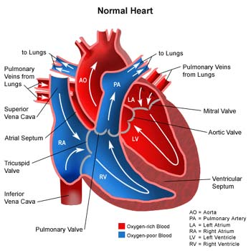
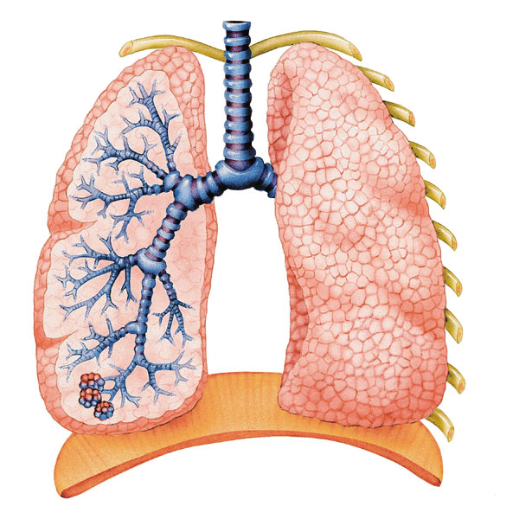
Recovery Heart Rate

Slide 2
Parkour/Free running

Slide 3
Parkour/Free Running
What internal parts of the body are allowing for these people to do this?

Slide 4
Parkour/Free Running
What internal parts of the body are allowing for these people to do this?
What body systems consist of the lungs, heart, veins, and arteries?

Slide 5
Parkour/Free Running
What internal parts of the body are allowing for these people to do this?
What body systems consist of the lungs, heart, veins, and arteries?
Besides food, what is fueling these free-runner’s body’s cells?

Slide 6
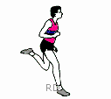
Recovery Heart Rate
Today we will be exploring how exercise affects your heart rate.

Slide 7
Recovery Heart Rate

Slide 8
Recovery Heart Rate

Slide 9
Recovery Heart Rate
(Page 10)

Slide 10
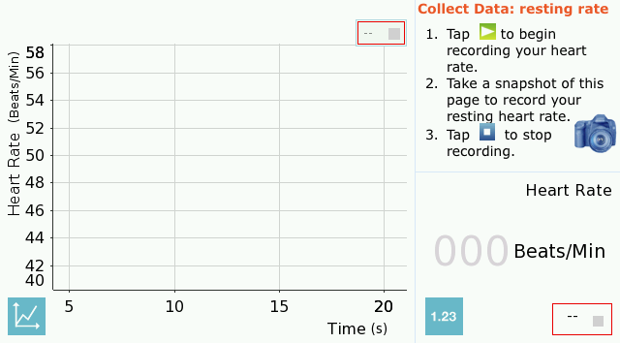
Recovery Heart Rate
(Page 11)

Slide 11
Recovery Heart Rate

Slide 12
Recovery Heart Rate

Slide 13
Recovery Heart Rate
Raise your hand if you had a resting heart rate greater than 80 beats per minute (bpm).

Slide 14
Recovery Heart Rate
Raise your hand if you had a resting heart rate greater than 80 beats per minute (bpm).
… if it’s less than 80 bpm.

Slide 15
Recovery Heart Rate
Raise your hand if you had a resting heart rate greater than 80 beats per minute (bpm).
… if it’s less than 80 bpm.
… if it’s less than 70 bpm.

Slide 16
Recovery Heart Rate
Raise your hand if you had a resting heart rate greater than 80 beats per minute (bpm).
… if it’s less than 80 bpm.
… if it’s less than 70 bpm.
… if it’s less than 60 bpm.

Slide 17
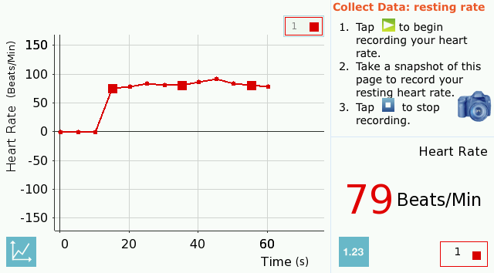
Recovery Heart Rate
(Page 14)

Slide 18
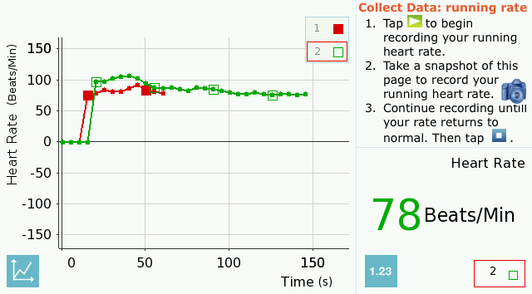
Recovery Heart Rate
(Page 14)

Slide 19
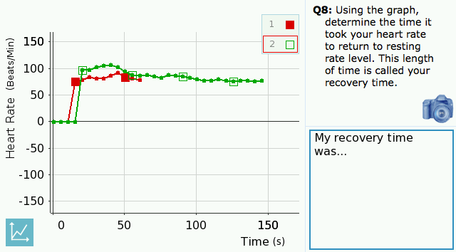
Recovery Heart Rate
(Page 18)

Slide 20
Recovery Heart Rate
The rate at which you breathe is called your respiration rate, or breathing rate.

Slide 21
Recovery Heart Rate
The rate at which you breathe is called your respiration rate, or breathing rate.
How did exercise affect your breathing rate?

Slide 22
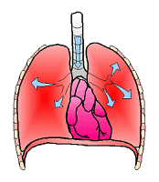
Respiratory System
What waste product does this system release?

Slide 23
Respiratory System
What waste product does this system release?
What structures does oxygen move into in the lungs?

Slide 24
Respiratory System
What waste product does this system release?
What structures does oxygen move into in the lungs?
What two structures allow movement to occur when lungs inhale and exhale?

Slide 25
Respiratory System
What waste product does this system release?
What structures does oxygen move into in the lungs?
What two structures allow movement to occur when lungs inhale and exhale?
How is oxygen collected and sent to the rest of the body?

Slide 26
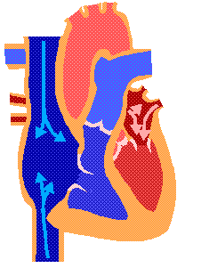
Circulatory system
What part of the heart pumps oxygen-poor blood to the lungs?

Slide 27
Circulatory system
What part of the heart pumps oxygen-poor blood to the lungs?
What part of the heart pumps oxygen-rich blood to the body?

Slide 28
Circulatory system
What part of the heart pumps oxygen-poor blood to the lungs?
What part of the heart pumps oxygen-rich blood to the body?
Do arteries carry oxygen-rich blood or oxygen-poor blood?

Slide 29
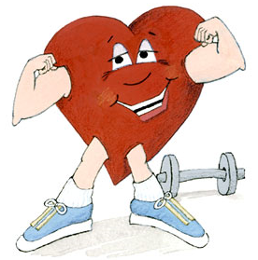
Fun Facts
On average, 20 steps burn one calorie.

Slide 30
Fun Facts
One drop of blood contains 5 MILLION Red Blood Cells, 10 Thousand White Blood Cells and 250 Thousand Platelets.

Slide 31
Fun Facts
"Bill Nye the Science Guy" claims that you could wrap your blood vessels around the equator TWICE!

Slide 32
Fun Facts
Your heart beats approximately 3 BILLION times during your lifetime!

Slide 33
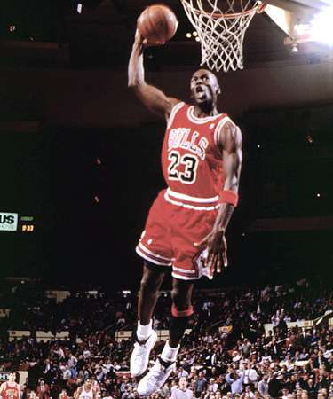
Recovery Heart Rate
Which one do you think has a faster heart rate?

Slide 34
Quick review
What does the circulatory system do?

Slide 35
Quick review
What does the circulatory system do?
What does the respiratory system do?

Slide 36
Quick review
What does the circulatory system do?
What does the respiratory system do?
What effect did exercise have on heart rate?

Slide 37
Quick review
What does the circulatory system do?
What does the respiratory system do?
What effect did exercise have on heart rate?
What effect did exercise have on respiration rate?

