Slide 1
Speed Rockets

Slide 2
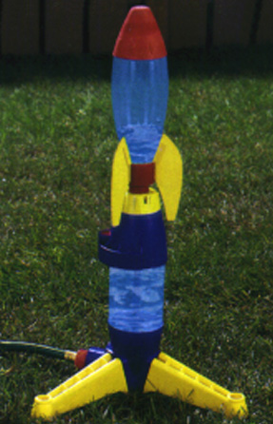
Water Rocket

Slide 3
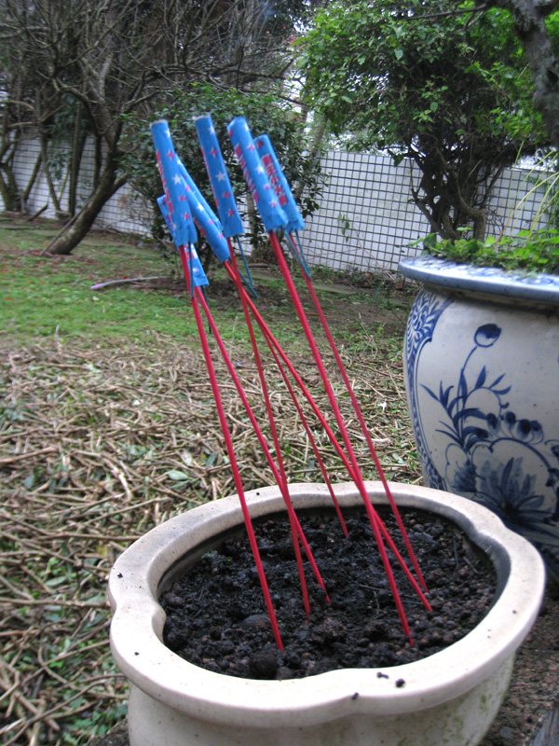
Bottle Rocket

Slide 4
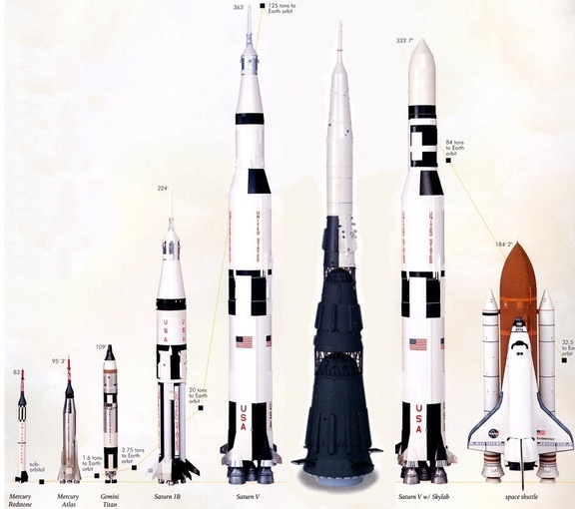
NASA’s Rockets

Slide 5
What do all these rockets have in common?

Slide 6
What makes all these rockets go?

Slide 7
Where do we often see speed measured? How is it measured?

Slide 8
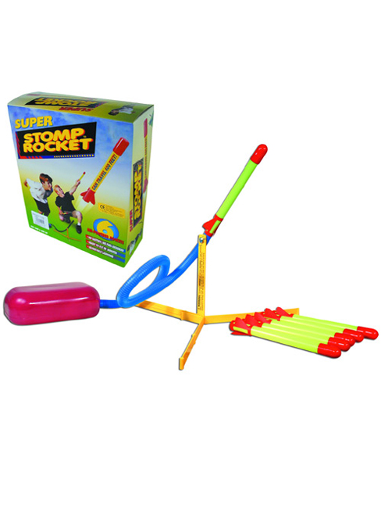
What we’re doing today!
Stomp rockets!

Slide 9
Safety
Stand behind the firing line at all times unless your job is to retrieve the rocket.
  When retrieving, do so quickly and keep watch for rockets flying at you.
Only shoot rockets into the field.
Do NOT shoot rockets at one another.

Slide 10
Directions
Person 1: The Launcher!
  Put rocket on nozzle.
  Launch rocket two times!
Person 2: The Timer!
  Use stop watch.
  Start time when launcher’s foot hits launch pad.
  End time when rocket hits the ground.
Person 3: The Distance Measurer!
  Retrieve the rocket after it has landed.
  Estimate how far it went by using cones.
Person 4: The Recorder!
  Write down the measurements of the time and distance in the appropriate boxes.
Each person will be rotating positions after two launches.

Slide 11
Data Chart
Trial # | T = Total time (seconds) | D = Distance traveled (meters) | S = Speed = D ÷ T (meters per second) | S × 2.23 (miles per hour)
1
2
3
4
5
6
7
8
9
10

Slide 12
Important
Each person will be rotating their positions.
You all will have 20 minutes to do this.
Do two launches and then switch with the next person.
Make sure everyone gets a turn.
Once the 20 minutes are up, we are stopping whether you are finished or not.
HAVE FUN EXPLORING SCIENCE!

Slide 13
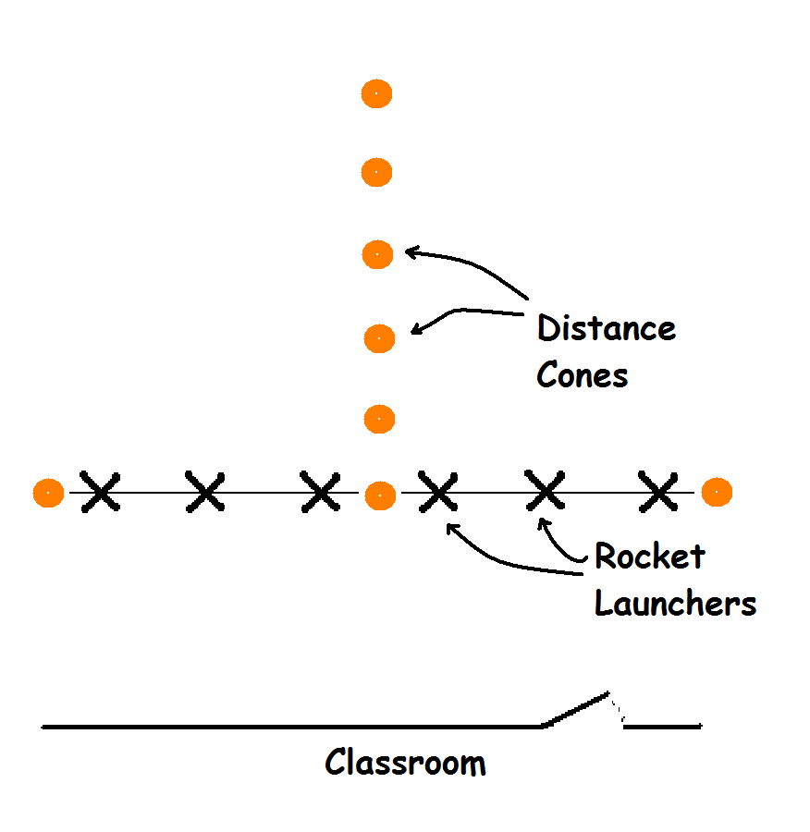

Slide 14
5…4…3…2…1…
Houston we have liftoff!

Slide 15
Calculation Time
Distance Traveled (meters)
Speed =
Total Time (second)
Conversion: Miles per Hour
Speed (m/s) X 2.23 = Miles Per Hour

Slide 16
Question Time
Please take the next ten minutes to write down your best answer for each question.

Slide 17
1. What was the greatest distance your group achieved with the rockets.

Slide 18
2. What was the greatest time your group achieved with the rocket?

Slide 19
3. What was the greatest average speed your group achieved with the rocket?

Slide 20
4. Describe the farthest flight of your air pressure-powered rocket.

Slide 21
5. Why do you think some flights were better than others?

Slide 22
6. Compare your Stomp Rocket’s launch speed with the speeds of other objects. How much faster or slower is the Stomp Rocket’s speed?

Slide 23
Can objects escape Earth’s gravity?

Slide 24
How fast must they be moving to do so?

Slide 25
Why would we want to escape Earth’s atmosphere?

