Slide 1
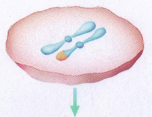
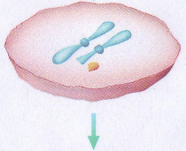
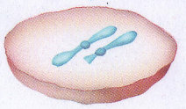
Deletion
Deletion – loss of a piece of chromosome due to breakage

Slide 2
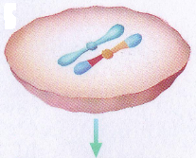
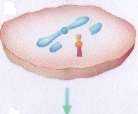
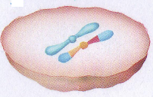
Inversion
Inversion – A chromosomal segment breaks off, flips around backwards, and reattaches.

Slide 3
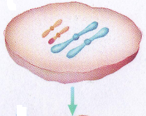
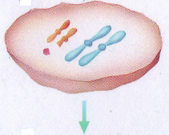
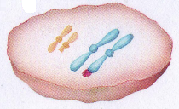
Translocation
Translocation – a piece of one chromosome breaks off and reattaches to a nonhomologous chromosome

Slide 4
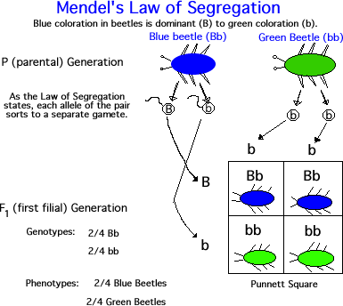
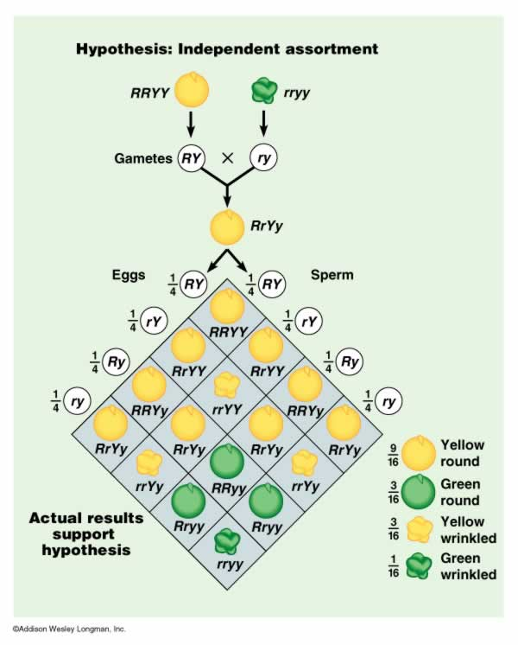
Mendel (Father of Genetics)
Mendel’s Laws of
Segregations and
Independent Assortment
Law of Segregation: states that the pairs of homologous chromosomes separate in meiosis so that only one chromosome from each pair is present in each gamete.
Law of Independent Assortment: states that genes separate independently of one another in meiosis.

Slide 5
Sample Item 11: Over time, the climate of an island became drier, which resulted in changes to the populations of various island finch species. Finch populations with a certain beak shape thrived, while those not having that beak shape decreased. Which of the following describes the necessary condition for these changes in the finch populations to occur?
Fewer mutations
Limited food resources
Limited beak variations
Overproduction of offspring

Slide 6
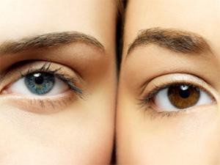
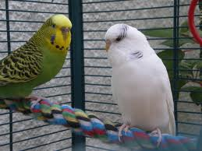
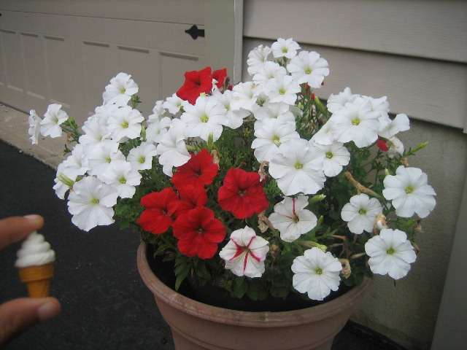
Dominant VS Recessive
Dominant: describes the allele that is fully expressed when carried by only one of a pair of homologous chromosomes.
Recessive: describes a trait or an allele that is expressed only when two recessive alleles for the same characteristic are inherited.

Slide 7
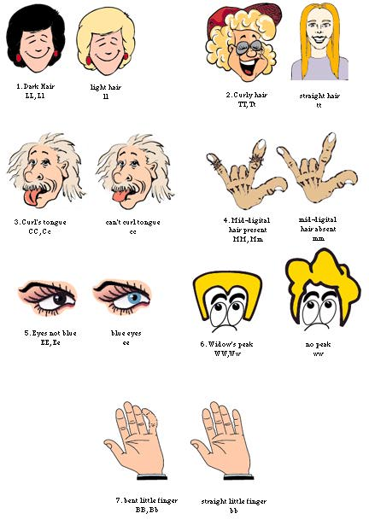
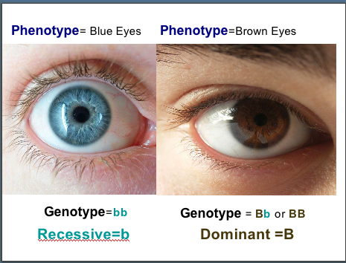
Genotype VS Phenotype
Genotype: The entire genetic makeup of an organism; also the combination of genes for one or more specific traits.
Phenotype: an organism’s appearance or other detectable characteristics that results from the organism’s genotype and the environment.

Slide 8
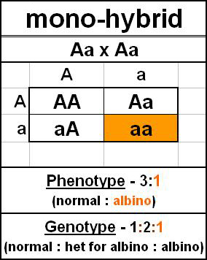
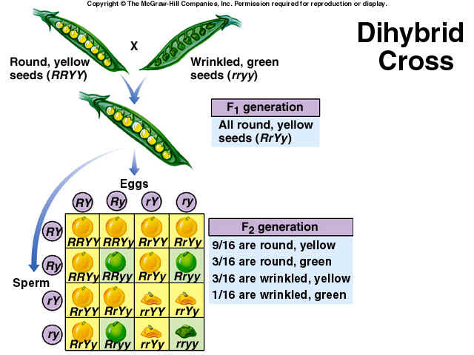
Punnett Square
Punnet Square: A graphic used to predict the results of a genetic cross.
Monohybrid cross:
a cross between individuals that involves one pair of contrasting traits.
Dihybrid cross: A cross between individuals that have different alleles for the same gene.

Slide 9
Experiments
P generation: parental generation, the first two individuals that mate in a genetic cross.
F1 generation: the first generation of offspring obtained from an experimental cross of two organisms.
F2 generation: the second generation of offspring, obtained from an experimental cross of two organisms; the offspring of the F1 generation.

Slide 10
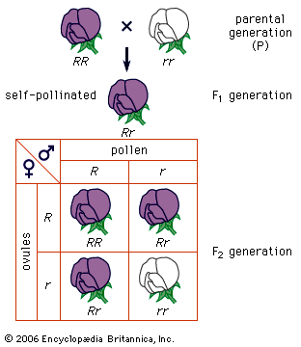
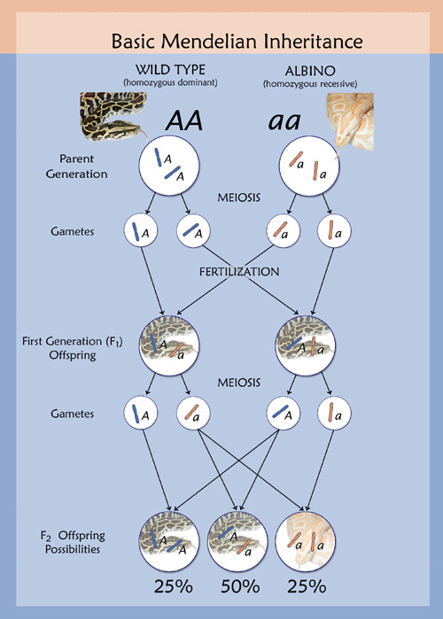
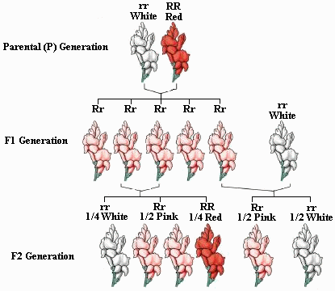

Slide 11
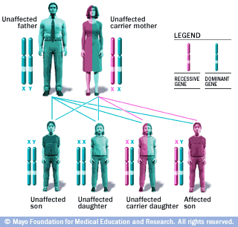
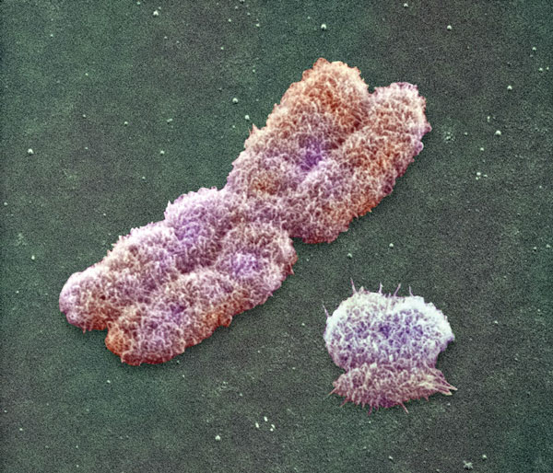
Red-Green Colorblindness
Sex Linked Trait
Sex-linked trait: a trait that is determined by a gene found on one of the sex chromosomes, such as the X chromosome or the Y chromosome in humans.

Slide 12
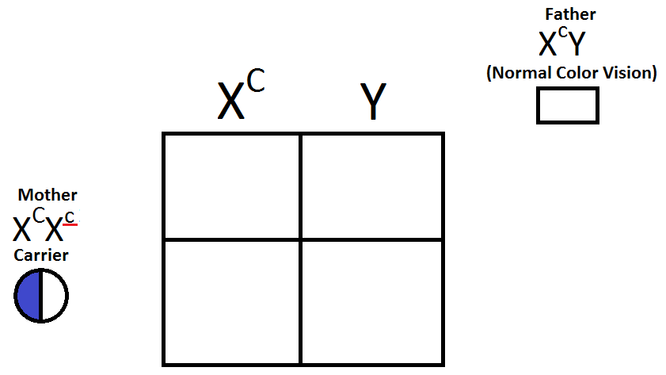
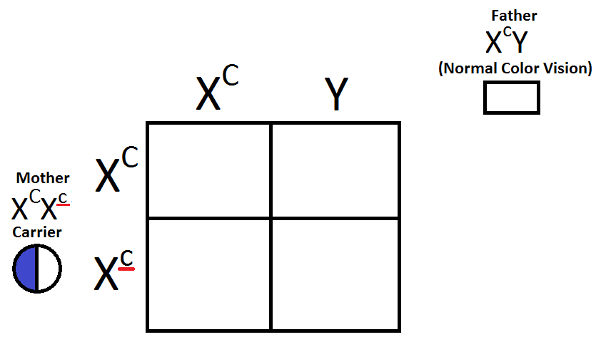
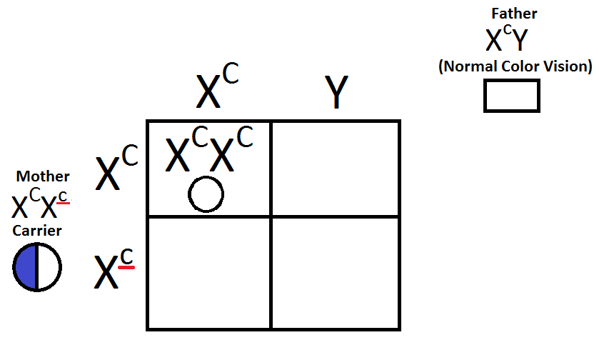
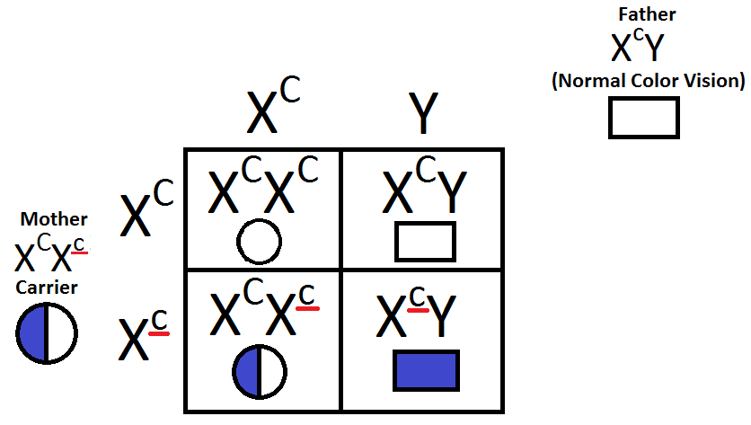
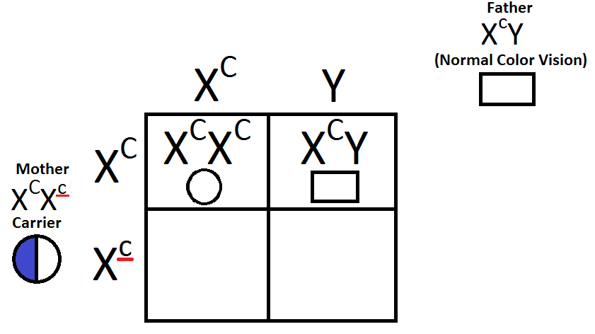
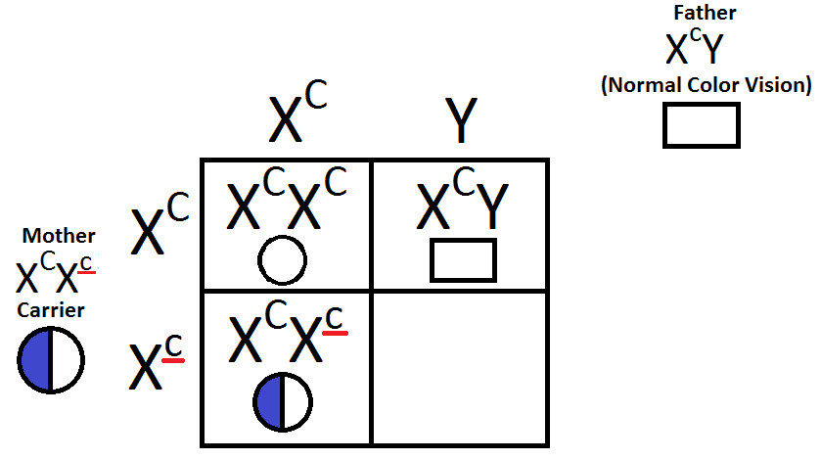
Example 1: Red-Green Colorblindness
Complete the Punnett Square to show color-blindness/ hemophilia.
The mother is a carrier. This is a person who has ONE recessive allele for a trait and ONE dominant allele for the trait.
She does NOT have the trait, but can pass it to her offspring.

Slide 13
Sample Item 12: Hemophilia is a sex-linked, recessive trait. Which of the following describes the probability of hemophilia in the offspring of a man who does not have hemophilia and a woman who is a heterozygous carrier?
There is a 100% chance that their sons will have hemophilia.
There is a 0% chance that their daughters will have hemophilia.
There is a 25% chance that their sons will have hemophilia.
There is a 50% chance that their daughters will have hemophilia.

Slide 14
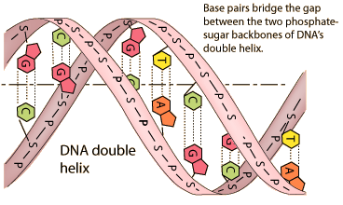
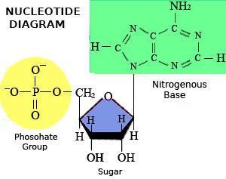
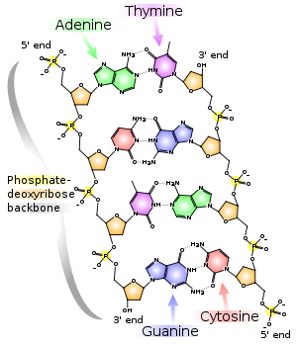
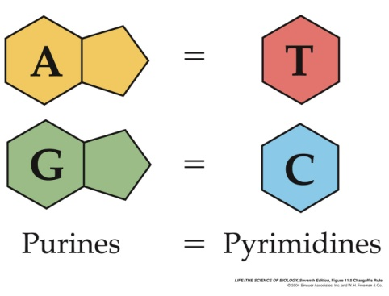
DNA
DNA (deoxyribonucleic acid): the material that contains the information that determines inherited characteristics.
Nucleotide: in a nucleic-acid chain, a subunit that consists of a sugar, a phosphate, and a nitrogenous base.
Nitrogenous base: contains nitrogen (N) atoms and carbon (C) atoms and is a base (accepts hydrogen ions)
Purines: nitrogenous bases that have a double ring of carbon and nitrogen atoms (Adenine and Guanine)
Pyrimidines: nitrogenous bases that have a single ring of carbon and nitrogen atoms (cytosine and thymine)

Slide 15
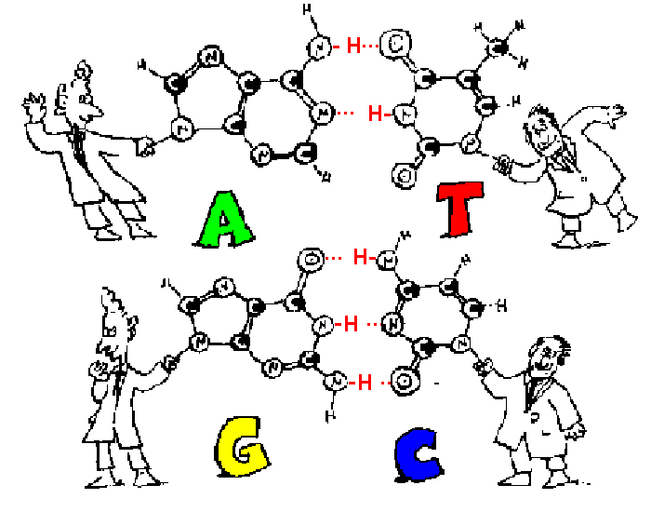
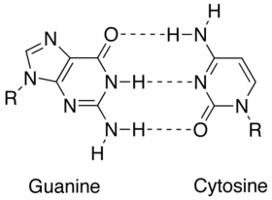
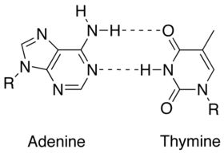
DNA cont.
Base Pairing rules: the rules stating that cytosine pairs with guanine and adenine pairs with thymine in DNA, and that adenine pairs with uracil in RNA.
Complimentary Base Pairs: contains one purine and one pyrimidine
A-T (like AT&T)
C-G (like Curious George)
A-U (RNA)

Slide 16
Types of RNA
Messenger RNA (mRNA): a single-stranded RNA molecule that carries the instructions from a gene to make a protein.
Ribosomal RNA (rRNA): a natural polymer that is present in all living cells and that plays a role in protein synthesis.
Transfer RNA (tRNA): an RNA molecule that transfers amino acids to the growing end of a polypeptide chain during translation.

Slide 17
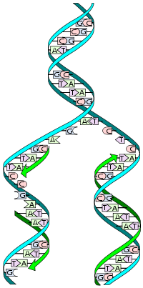
Replication
DNA Replication: the process of making a copy of DNA.
Helicase: separate the DNA strands
Replication Fork: The Y-shaped region that results when the two strands separate
DNA Polymerases: add complementary nucleotides, found floating freely inside the nucleus, to each of the original strands.
Semi-Conservative Replication: Each new DNA molecules have kept (or conserved) one of the two (or semi) originals DNA strands.

Slide 19
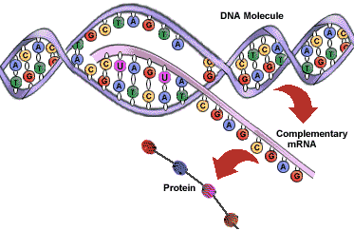
Transcription
RNA polymerase: enzyme that catalyzes the formation of RNA on a DNA template, binds to a promoter.
Promoter: specific nucleotide sequence of DNA where RNA polymerase binds and initiates transcription.
Termination signal: specific sequence of nucleotides that marks the end
of a gene.
UAA, UAG, UGA

Slide 20
