Slide 1
Domain Archaea
1. Prokaryotes
2. Distinctive cell membranes
3. Autotrophic (chemosynthesis), earliest organisms on Earth
4. Some produce gases
5. Live in harsh environments

Slide 2
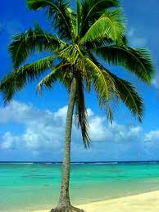
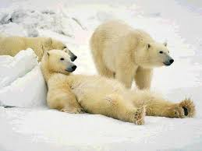
Domain Eukarya
1. Eukaryotic
2. Large cells
3. True nucleus
4. Complex cellular organelles
5. Plants, animals, fungi, plus variety of single-celled organisms

Slide 3
6 Kingdoms
Eubacteria
Archaebacteria
Protista
Fungi
Plantae
Animalia

Slide 4
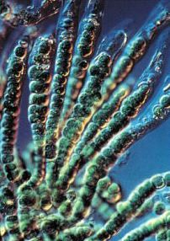
Kingdom Eubacteria
Prokaryotic
Have cell wall and cell membrane
All unicellular
Heterotrophic and autotrophic
Motile (flagella)
Examples: E.coli, Cyanobacteria, Chlamydia (STI)

Slide 5
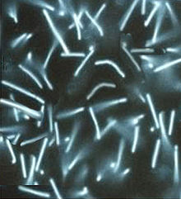
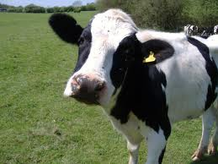
Kindgom Archaebacteria
Prokaryotic
Have cell wall and cell membrane
Unicellular
Heterotrophic and autotrophic
Motile
Ex: methanogens (gas), halophiles (salt), thermoacidophiles (hot springs)

Slide 6
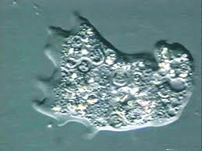
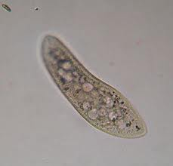
Kingdom Protista
Eukaryotic
Have cell wall (some) and cell membrane
Mostly unicellular, some multicellular forms
Autotrophic, heterotrophic
Motile
Ex: Euglena, Paramecium, Amoeba

Slide 7
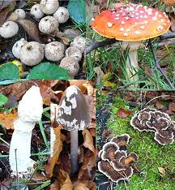
Kingdom Fungi
Eukaryotic
Have cell wall and cell membrane
Unicellular and multicellular
Heterotrophic (secrete digestive enzymes)
Sessile
Ex: Mushrooms, puffballs, mildew, mold

Slide 8
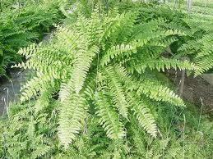
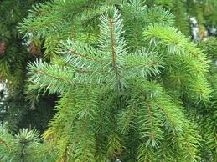
Kingdom Plantae
Eukaryotic
Have cell wall and cell membrane
Multicellular
Autotrophic (photosynthesis)
Sessile
Ex: Ferns, mosses, pine tree

Slide 9
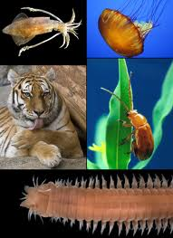
Kingdom Animalia
Eukaryotic
Have cell membrane
Multicellular
Heterotrophic
Motile
Ex: Worms, fish, humans (Largest kingdom!)

Slide 10
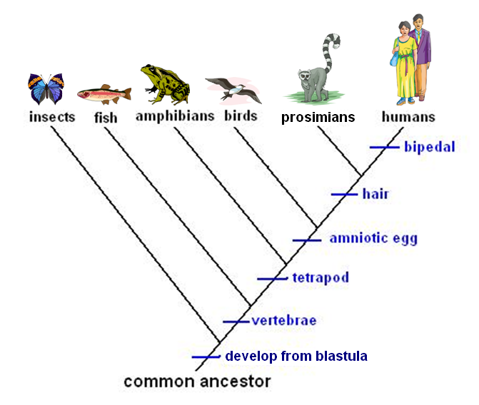
Cladogram
Change in classification due to genetics and evolution
Cladogram: a diagram that is based on patterns of shared, derived traits and that shows the evolutionary relationships between groups of organisms.

Slide 11
Sample Item 9: Organisms classified as fungi have unique characteristics. Which of the following characteristics is found only in organisms classified in the kingdom Fungi?
Single cell without a nucleus
Multicellular with chloroplasts
Multicellular filaments that absorb nutrients
Colonies of single, photosynthetic cells that reproduce asexually

Slide 12
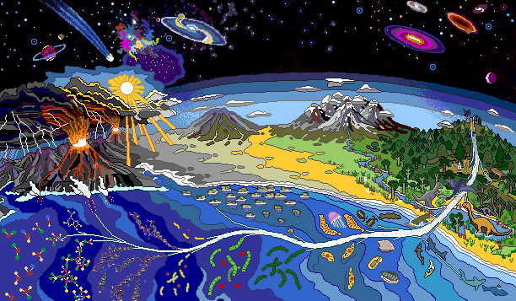
Origin of Life on Earth

Slide 13
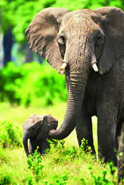
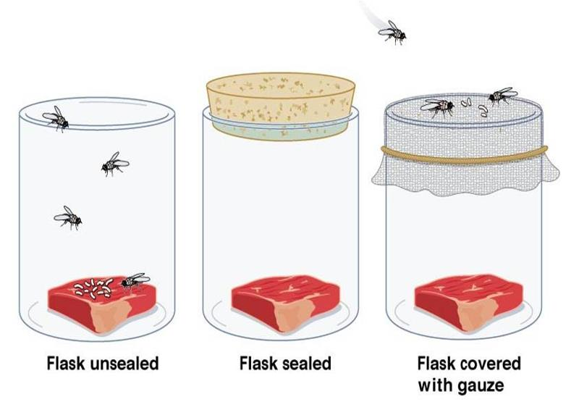
Biogenesis VS
Spontaneous Generation
Spontaneous Generations: an early and now disproved theory that living organisms come to life spontaneously from nonliving material.
Biogenesis: the scientific principle that living organisms come only from other living organisms.

Slide 14
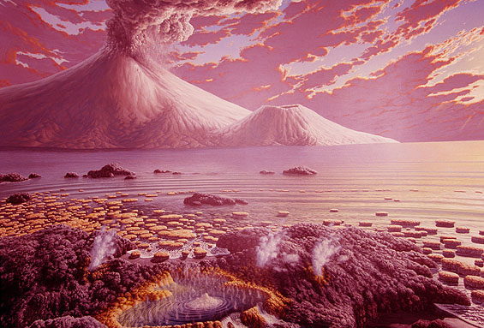
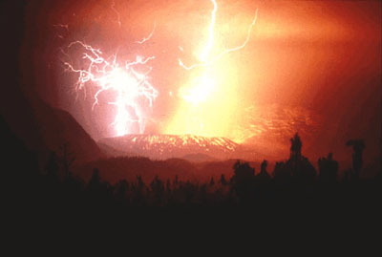
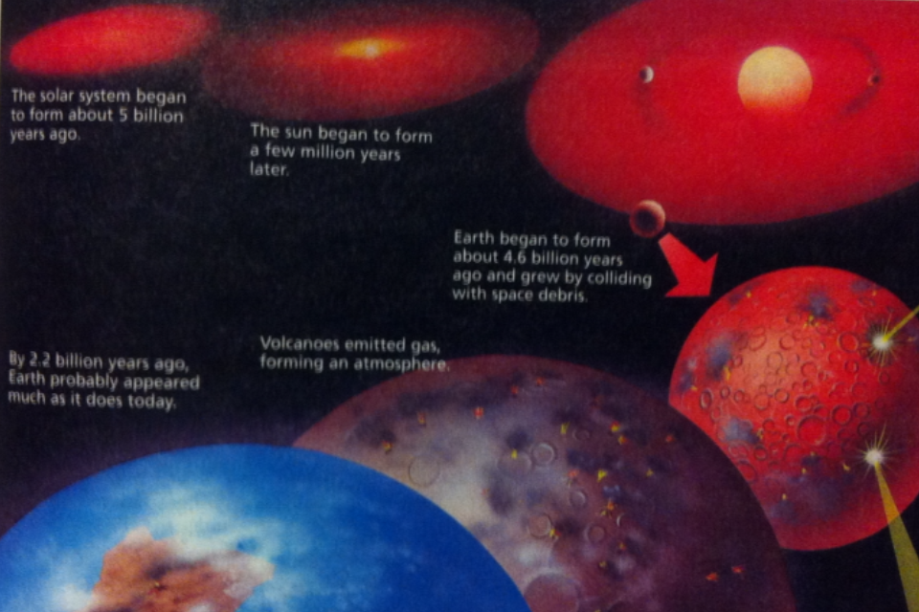
Early Earth
Volcanoes, toxic, very hot, Early atmosphere: NH3, H2, H2O, and CH4

Slide 15
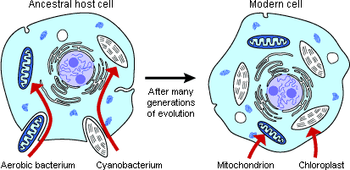
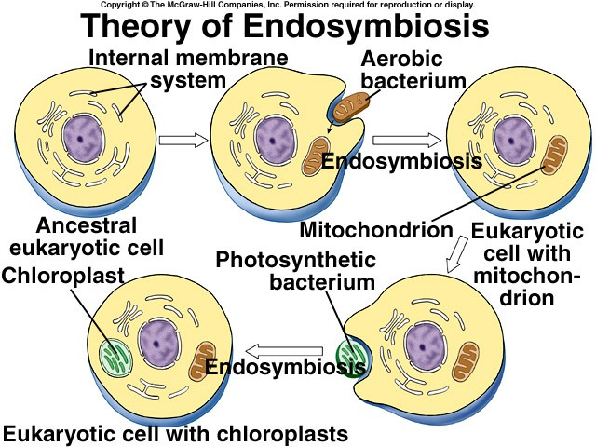
Endosymbiosis
Endosymbiosis:
A mutually beneficial relationship in which one organism lives within another; a theory that eukaryotic cells originated through endosymbiotic relationships between ancient prokaryotic cells.

Slide 16
Sample Item 10: One of the accepted scientific theories describing the origin of life on Earth is known as chemical evolution. According to this theory, which of the following events would need to occur first for life to evolve?
Onset of photosynthesis
Origin of genetic material
Synthesis of organic molecules
Formation of the plasma membrane

Slide 17
Natural Selection
Natural Selection: the process by which individuals that are better adapted to their environment survive and reproduce more successfully than less well adapted individuals do; a theory to explain the mechanism of evolution.
Picture from book

Slide 18
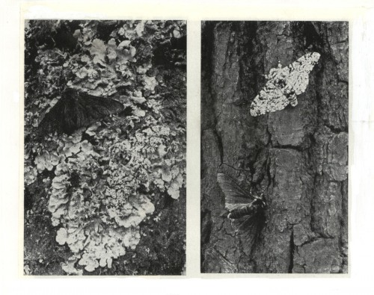
4 Steps of Natural Selection
1. Overproduction: each species produces more individuals than can survive to maturity.
4. Differential Reproduction: Individuals that have certain traits are more likely to survive and reproduce that are individuals that lack those traits. Over time, those traits become more frequent in the populations.
2. Genetic Variation: The individuals of a population may differ in traits such as size, color, strength, speed, ability to find food, or resistance to certain diseases.
3. Struggle to Survive: Individuals must compete with each other for limited resources. Also, some individuals will be harmed by predation, disease, or unfavorable conditions.

Slide 19
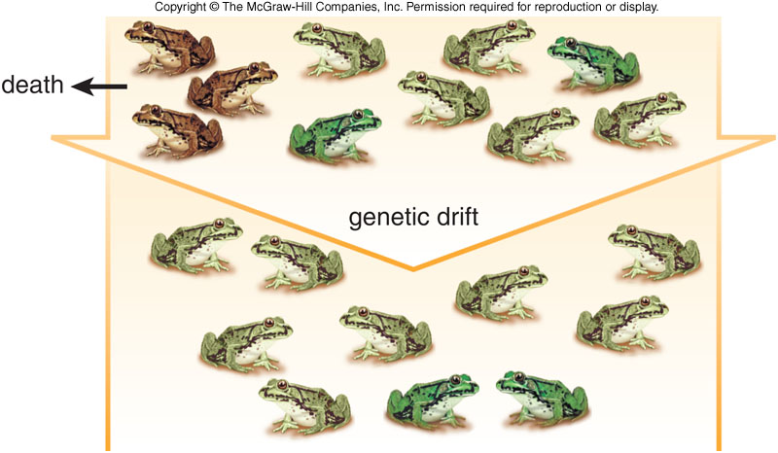
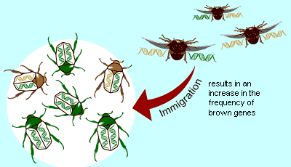
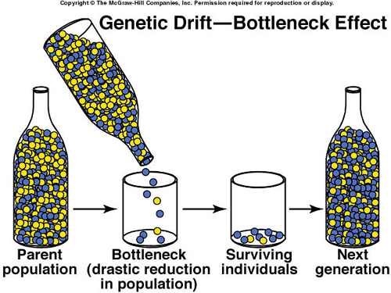
Genetic Drift
Genetic Drift: the random change in allele frequency in a population.
Gene Flow: the movement of genes into or out of a population due to interbreeding.

Slide 20
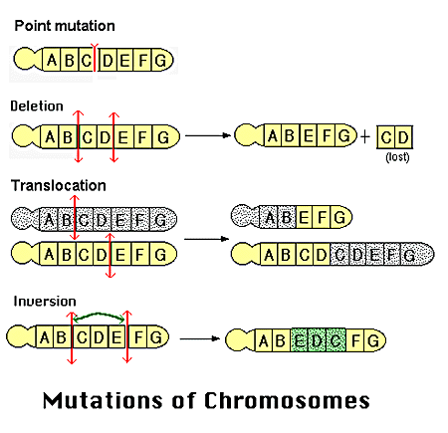
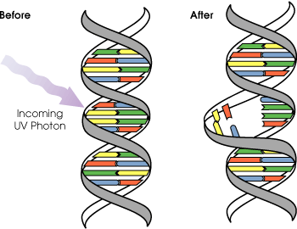
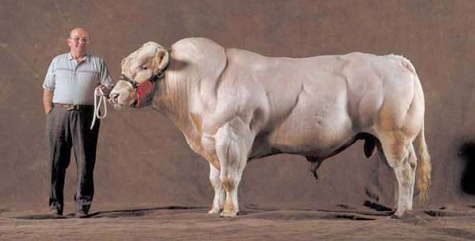
Mutations
Mutation: A change in the nucleotide-base sequence of a gene or DNA molecule
Mutation + Genetic Recombination = Increased Genetic Variation.
Marfan's Syndrome: a connective tissue disorder which characterized by long limbs and long, thin fingers.

