Slide 1
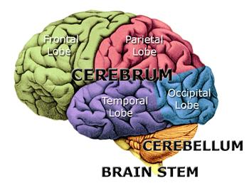
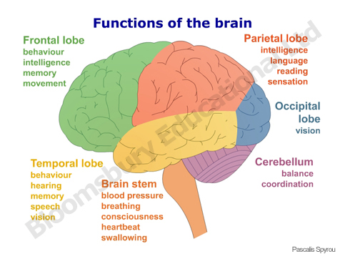
Cerebrum: the upper part of the brain that receives sensation and controls movement.
The BRAIN
Cerebellum: A posterior portion of the brain that coordinates muscle movement and controls subconscious activities and some balance functions.
Brainstem: the stem like portion of the brain that connects the cerebral hemispheres with the spinal cord and that maintains the necessary functions of the body, such as breathing and circulation.

Slide 2
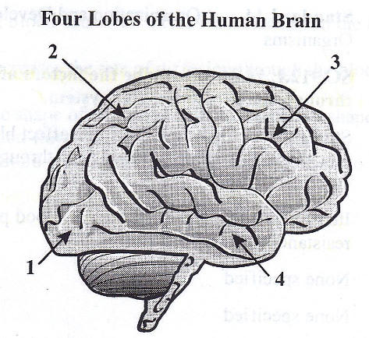
Sample Item 5: The illustration below shows four lobes of the human brain.
What lobe is designated by label 2?
Temporal
Parietal
Occipital
Frontal

Slide 3
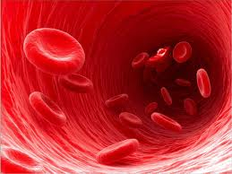
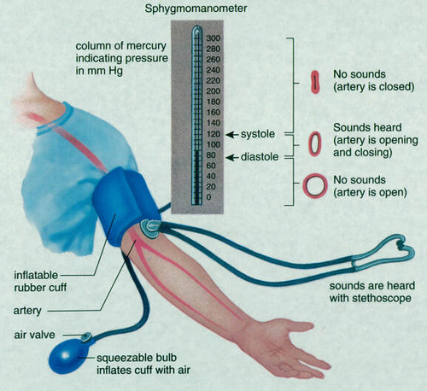
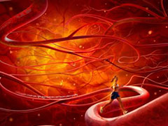
Blood Flow
Factors Affecting Blood Flow
Disease
Ex. Atherosclerosis (hardening of arteries)
Blood Pressure
Plaque in Vessels
Exercise

Slide 4
Sample Item 6: The rate at which blood flows through the human body changes in response to many factors. Which statement describes one of these factors and its effect on blood flow?
A high viscosity of blood causes an increased resistance in the blood vessels and leads to slow blood flow.
A low blood pH decreases the rate of diffusion through the blood vessels and leads to slow blood flow.
The changing of the shape of red blood cells to a crescent shape decreases resistance and leads to a faster blood flow.
The narrowing of blood vessels increases pressure and leads to a faster blood flow.

Slide 5
Immune System
Body’s defense: helps protect the body against any pathogen, regardless of the pathogen’s identity.
1st line of defense: Barriers!
ie. Skin and mucous membrane.
Mucous membrane: epithelial tissues that protect the interior surfaces of the body that may be exposed to pathogens.
2nd line of defense: Nonspecific Immunity!
Inflammatory response, temperature response, proteins.
Phagocytes: (inflammatory response) ingest and destroy pathogens and foreign matter.

Slide 6
Immune System Cont.
Immune System: the cells and tissues that recognize and attack foreign substances in the body.
Thymus: gland helps produce special lymphocytes.
Lymphocytes: white blood cells
T cells-cell derived from thymus; participates in many immune reactions mediated by cells.
B cells-white blood cell that matures in bones and makes antibodies.

Slide 7
Steps to Immune Systems
1. Recognize Pathogens
Antigen: any substance that the immune system can recognize and react with.
2. Immune Response
Helper T cells- white blood cell necessary for B cells to develop normal levels of antibodies.

Slide 8
Immunity and Vaccination
Immunity: ability to resist an infectious disease.
Vaccination: introduction of antigens into the body to cause immunity.
Injection of vaccine
Vaccine: a solution that contains a dead or weakened pathogen or material from a pathogen.
Problems with Immune System
Allergies-physical response to antigen
Asthma-respiratory disorder causes narrow bronchioles
Autoimmune disease- immune system attacks the organism’s own cells.

Slide 9
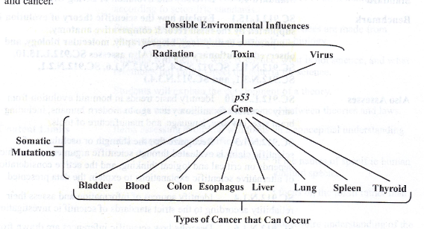
Sample Item 7: The p53 gene codes for the p53 protein that locates DNA errors for cellular repair. The diagram below shows the relationship among possible environmental influences, the p53 gene, and cancer.
Which of the following statements best describes the relationship among possible environmental influences, the p53 gene, and cancer?
Environmental influences can lead to mutations in the p53 gene, which can cause certain cancers.
Increased levels of p53 protein, rather than environmental influences, can cause certain cancers.
Mutations in the p53 gene increases environmental influences that can cause certain cancers.
Genes such as p53 are less casual than environmental influences in stimulating certain cancers.

Slide 10
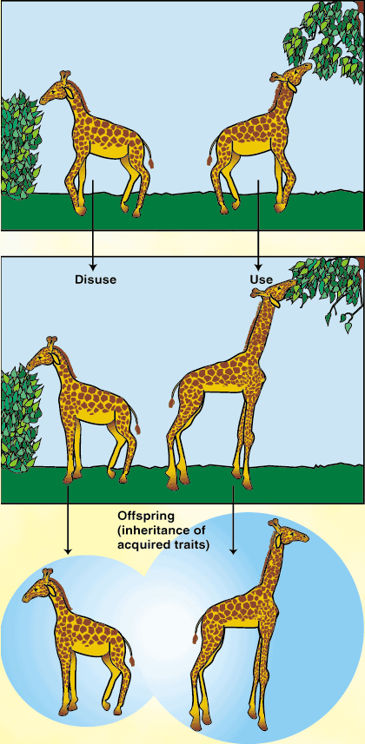
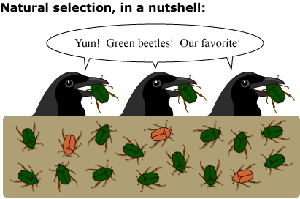
Darwin VS Lamarck
Theory of Natural Selection: (Darwin) The process by which individuals that are better adapted to their environment survive and reproduce more successfully than less well adapted individuals do; a theory to explain the mechanism of evolution.
Inheritance of Acquired Characteristics: (Lamarck) Individuals could acquire traits during their lifetimes as a result of experience or behavior, then could pass on those traits to their offspring.

Slide 11
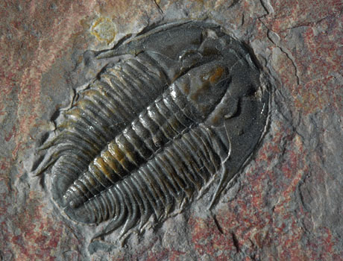
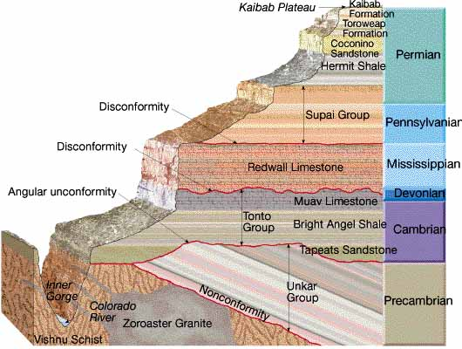
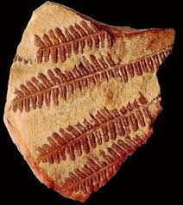
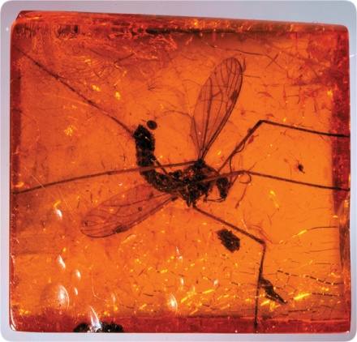
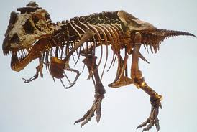
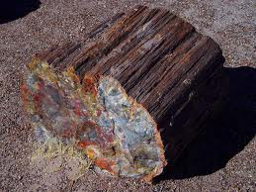
Evidence for Evolution
trilobite
Fossils
Law of Superposition: if the rock strata at a location have not been disturbed, the lowest stratum was formed before the strata above it.

Slide 12
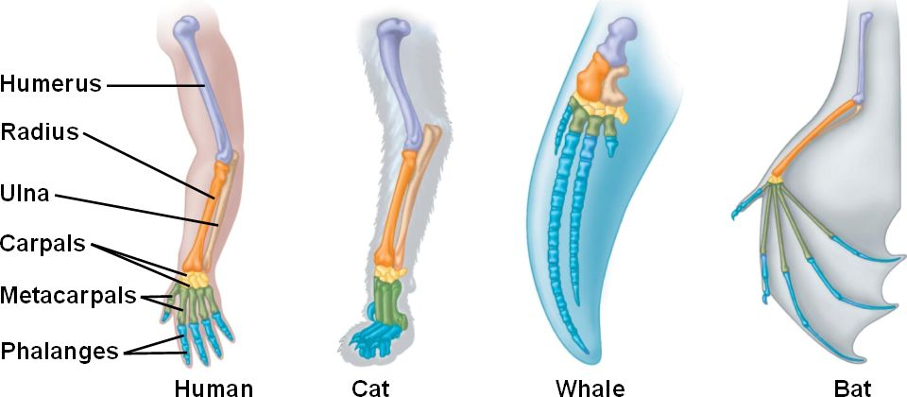
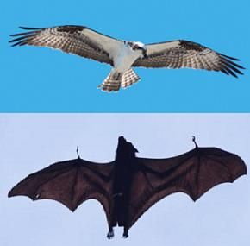
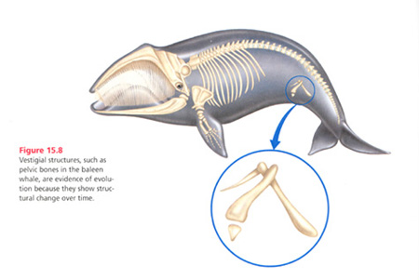
Evidence for Evolution cont.
2. Anatomy
Analogous: an anatomical structure in one species that is similar in function and appearance, but not in evolutionary origin, to another anatomical structure in another species.
Homologous: anatomical structures in one species that, compared to other anatomical structures in another species, originated from a single anatomical
structure in a
common
ancestor
of the two
species.
Vestigial: A structure in an organism that is reduced in size and function and that may have been complete and functional in the organism’s ancestors.

Slide 13
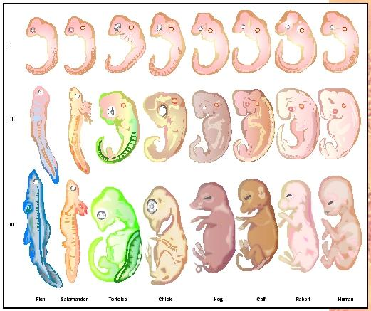
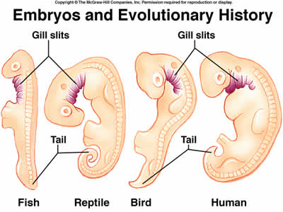
Evidence for Evolution cont.
3. Embryological- analysis of vertebrate embryos such as the fish, check, and cat are remarkably similar at certain stages. This pattern would be expected if all were descended from a common ancestor.

Slide 14
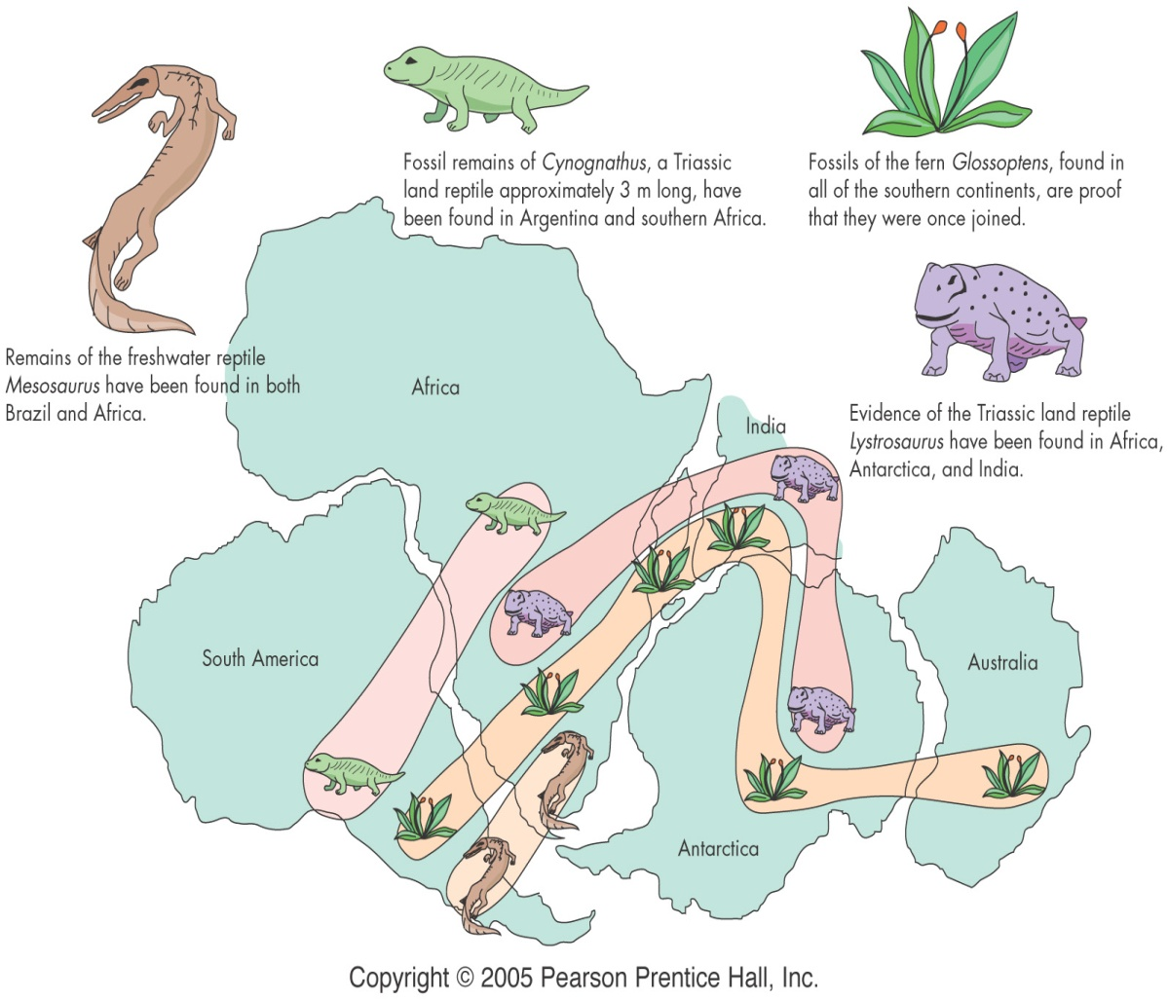
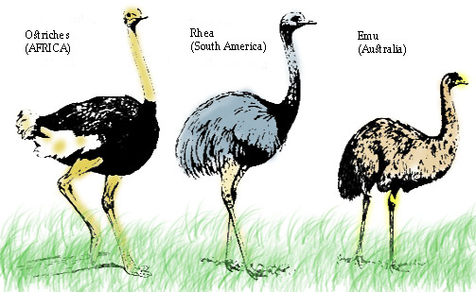
Evidence for Evolution cont.
4. Biogeography – The study of locations of organisms around the world.
(continental drift, Pangaea)

Slide 15
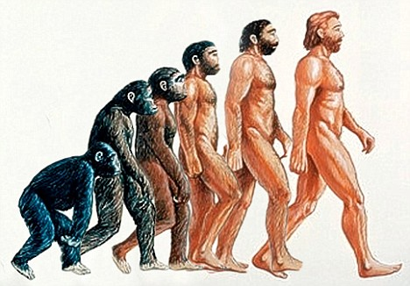
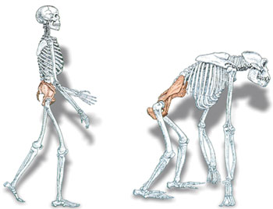
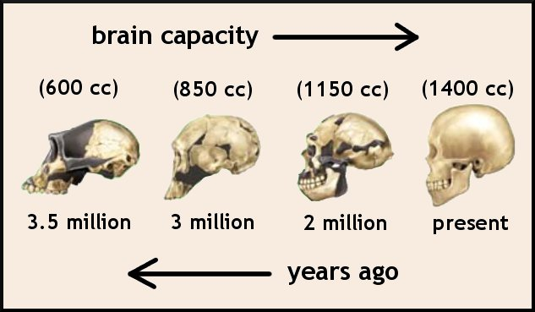
Hominid Evolution
Early Man to Modern Man (bipedal, larger brain)

Slide 16
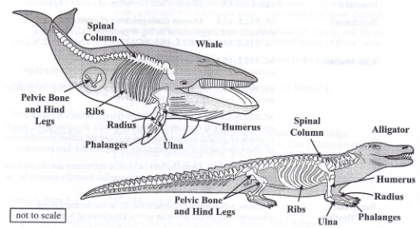
Sample Item 8: The scientific theory of evolution is supported by different types of evidence. The diagrams below show the skeletons of two different animal species.
How does comparing the skeletons of these animals provide support for the scientific theory of evolution?
It provides information about the organisms’ habitats.
It shows possible common ancestry between organisms.
It provides information to determine the organisms’ age.
It shows possible chromosomal similarities between organisms.

Slide 17
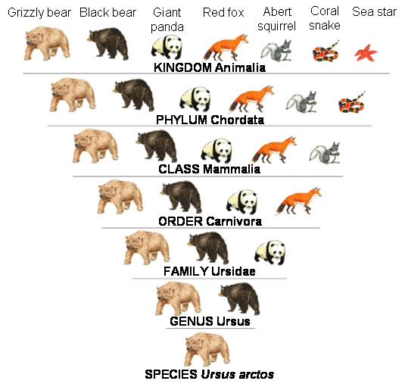
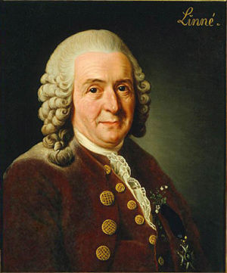
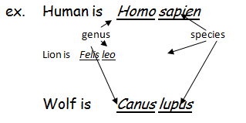
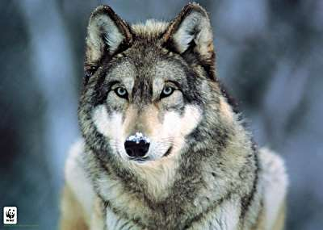
Taxonomy
Charles Linnaeus
Classification
Binomial Nomenclature: A system for giving each organism a two-word scientific name that consists of the genus name followed by the species name.

Slide 18
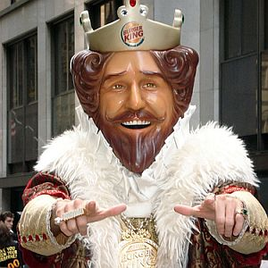
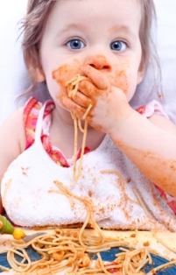
Kingdom Phylum Class Order Family Genus Species
King
Phillip
Came
Over
For
Great
Spaghetti

Slide 19
3 Domains of Life
Domain Bacteria
Prokaryotes
Cell wall (usually)
Reproduce by cell division
(Traditional Kingdom: Eubacteria)
Domain Archaea
Prokaryotes
Live in extreme environment
Differentiated from other prokaryotes by various important chemical factors.
(Traditional Kingdom: Archaebacteria)
Domain Eukarya
Eukaryotes
(Tradtional Kingdom: Protista, Fungi, Plantae, Animalia)

Slide 20
Domain Bacteria
1. small, single celled
2. Prokaryotic (lack a true nucleus)
3. Have a cell wall and plasma membrane
4. One circular chromosome
5. Oldest known fossils of cells

