Slide 1
DNA Replication

Slide 2
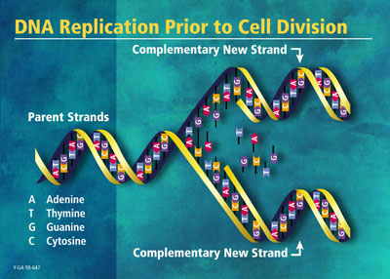
DNA Replication
The process by which DNA is copied in a cell before a cell divides by mitosis, meiosis, or binary fission.

Slide 3
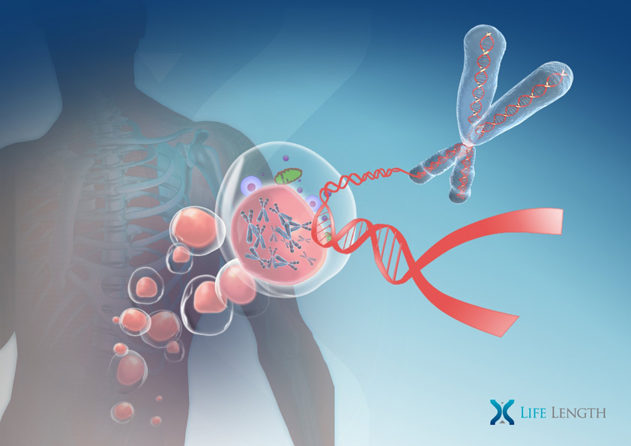
Where?
Nucleus of cell – Chromosomes

Slide 4
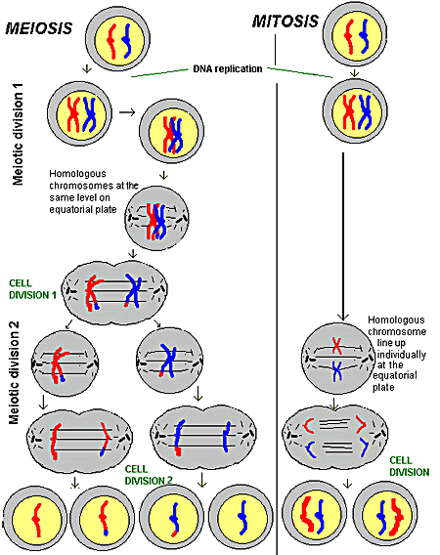
When?
Mitosis – Interphase
(S Phase)
Meiosis – Meiosis 1
(Interphase)

Slide 5
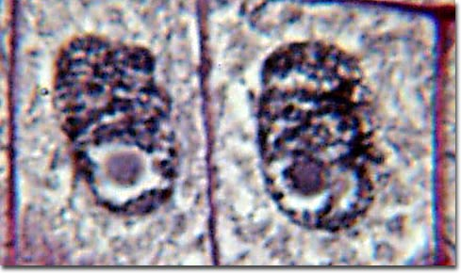
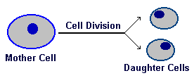
Why?
So genetic information can be in new cells (offspring cells)

Slide 6
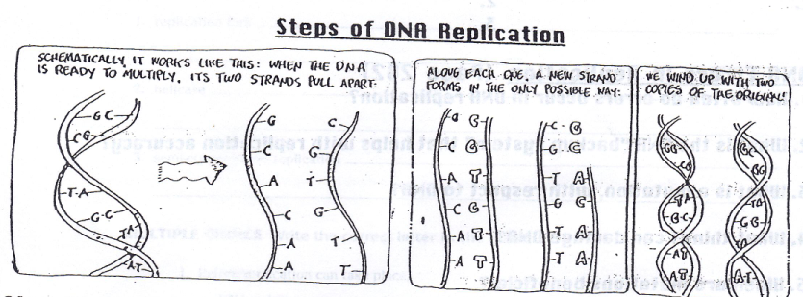
Steps of DNA Replication

Slide 7
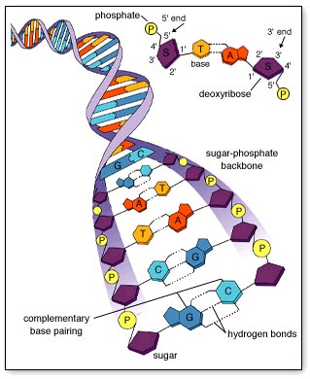
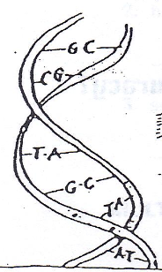
Step 1
DNA molecule before copying begins

Slide 8
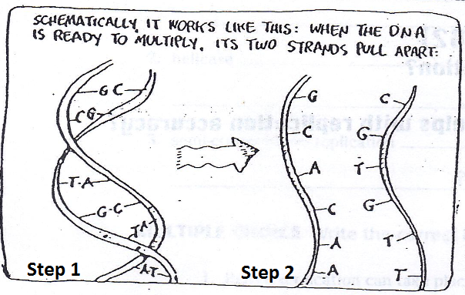
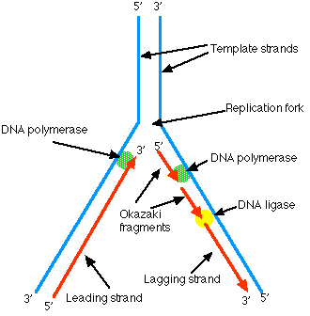
Step 2
An enzyme, helicase, breaks the bonds between the complementary base pairs (A-T and C-G) and “unzips” the DNA molecule.
The Y shaped region that results when 2 strands separate is called a replication fork.

Slide 9
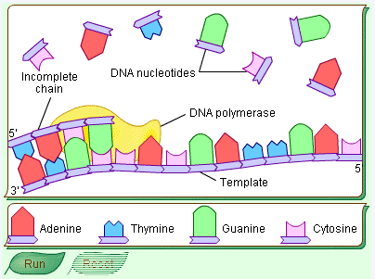
Step 3
A. Enzymes called DNA Polymerases add complementary nucleotides to each of the original strands (“Junk DNA” floats freely in the nucleus).
The order of base pairs in the new double helix exactly matches the order in the original DNA helix.

Slide 10
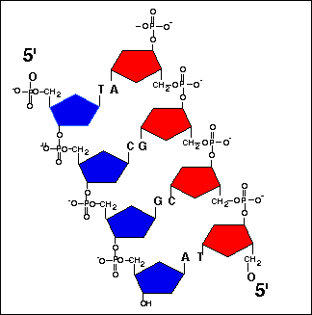
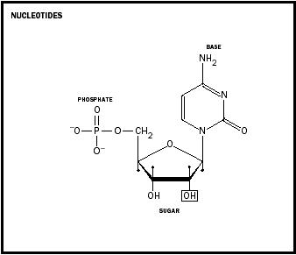
Step 3 (cont.)
B. Covalent bonds will form between the adjacent nucleotides.
They will also form between the sugar of 1 nucleotide and the phosphate of the next nucleotide.

Slide 11
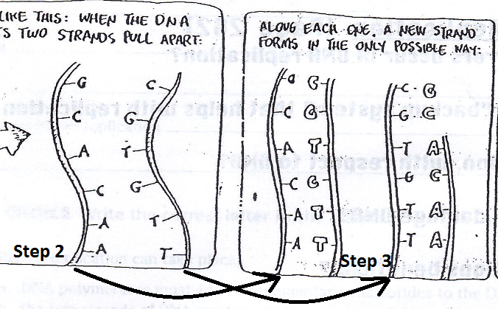
Step 3 (cont.)
C. Hydrogen bonds form between the complementary bases on the new and original strands.

Slide 12
Step 4
DNA Polymerases finish replicating the DNA and fall off.
The sides of each new DNA strand have formed.
There are now 2 complete and identical DNA ladders.
Each new molecule contains one strand of original DNA and one new strands.
(Original strand = template)
Semi-Conservative replication – each new DNA molecule has kept or conserved one of the 2 original strands. (Picture 4)

Slide 13
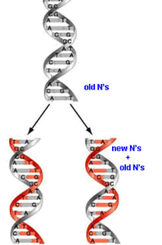
Step 4

Slide 14
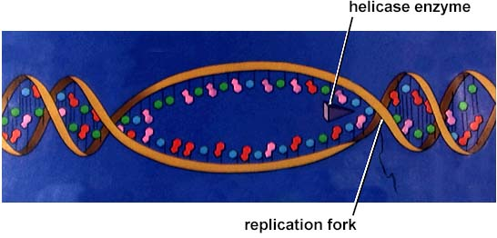
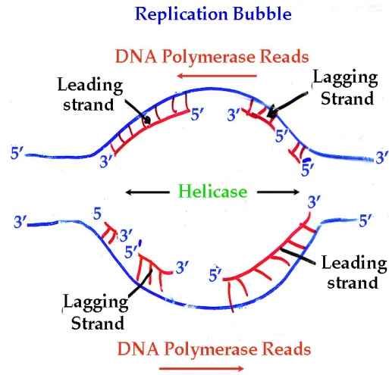
DNA Synthesis
DNA synthesis occurs in different directions at the replication fork. The enzyme, DNA ligase, pulls the gap inward later.
Ex.
Similar to opening a backpack from the middle.
After replication, Prophase begins.

Slide 15
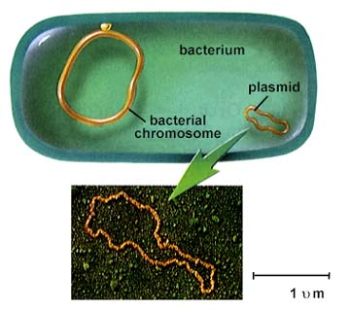
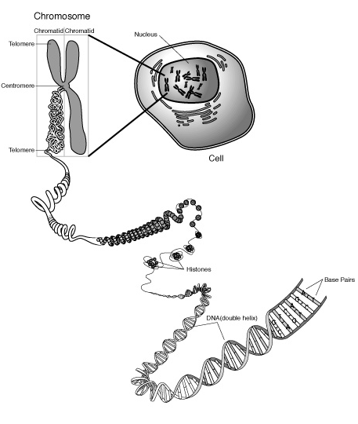
Prokaryotic VS Eukaryotic Replication
Prokaryotic Replication (Binary Fission) | Eukaryotic Replication
1. 1 Circular Chromosome | 1. Each Chromosome is long
2. Replication begins at 1 place of location | 2. Replication begins at many points
 | 3. DNA polymerase adds 50 nucleotides per stand

Slide 16
Video Summary
http://www.youtube.com/watch?v=zdDkiRw1PdU&feature=related

