Slide 1
Developing of the Periodic Table and Classifying its Elements.

Slide 2
Meet the Elements

Slide 3
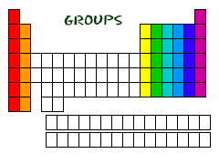
The Modern Periodic Table
Groups: (families) The boxes that are arranged in order of increasing atomic number into a series of vertical columns (up and down).
8 groups total.

Slide 4
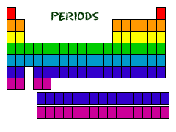
Periods: The horizontal rows (left to right) of elements.
7 periods total.

Slide 5
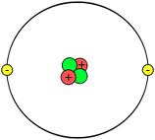
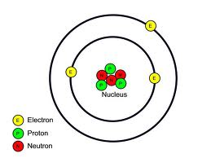
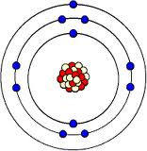
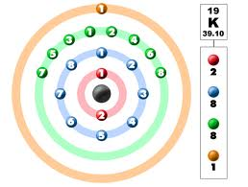
Valence Electrons
Period 1 Hydrogen 1s¹
Period 2 Lithium 1s²2s¹
Period 3 Sodium 1s¹2s²2p⁶3s¹
Period 4 Potassium 1s¹2s²2p⁶3s²3p⁶4s¹

Slide 6
IMPORTANT
Atoms in the same group have similar chemical properties because they have the same number of valence electrons.
Group 1A Valence Electron Configuration of s¹
Group 2A s²

Slide 7
Valence Electron and Period
Energy level of the element’s valence electrons indicates the period on the periodic table in which it is found.
Example
Period 2 Lithium 1s¹2s¹

Slide 8
Valence Electrons and Group Numbers
Group 1A One valence electron
Group 2A Two valence electrons
Group 8A eight valence electrons

Slide 9
Blocks

Slide 10
S-block elements
Groups 1A and 2A and H and He
Group 1A only holds 1 valence electron.
Group 2A only holds 2 valence electrons.
S orbitals only hold 2 electrons so it only spans to two groups.

Slide 11
P-block elements
Groups 3A through 8A.
Spans to six groups because the p orbital can hold a max of 6 electrons.

Slide 12
D-block elements
Contains the transition metals and is the largest of the blocks.
Energy level = n-1
Example Ni [Ar]4s13d8
is in energy level n=4
D orbitals are n-1 = 3
Five d orbitals can hold a total of 10 electrons, so it is 10 groups.

Slide 13
F-block elements
Inner transition metals
Filled or partially filled s orbital and 4f and 5f
Don’t fill up orbitals in a predictable manner.
7 orbitals holding a max of 14 electrons, there are 14 columns.

Slide 14
The importance of the blocks
They organize our periodic table.
Period 1 = s blocks
Periods 2, 3 = s and p blocks
Periods 4,5 = s, p, d blocks
Periods 6, 7 = s, p, d, f blocks

Slide 15
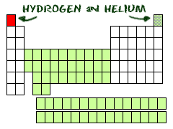
Some exceptions
Hydrogen can have the talents and electrons of two groups, one and seven.
Helium can only have two electrons in its outer shell.
The elements in the center section are called transition elements. They have special electron rules.

Slide 16
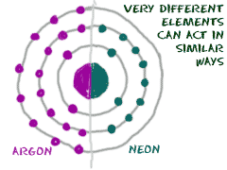
Families
Grouped together by chemical properties, usually in columns and also series.
Similar physical and chemical properties, such as:
Melting Point
Boiling Point
Valence
Reactivity

Slide 17
Groups
Groups are categorized with an A or a B
1A through 8A are the “main group” or representative elements because they posses a wide range of chemical and physical properties.
1B through 8B are transition elements

Slide 18
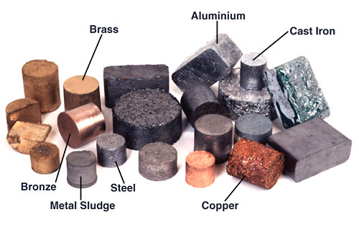
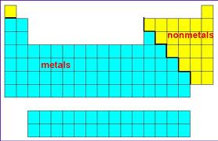
Metals
Metals- elements that are generally shiny when smooth and clean, solid at room temperature, and good conductors of heat and electricity.
Most are malleable and ductile, meaning that they can be pounded into thin sheets and drawn into wires.

Slide 19
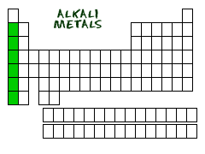
Alkali Metals
The group 1A (except H) on the left side of the periodic table.
Very reactive! Why?
Alkali Metals in Water

Slide 20
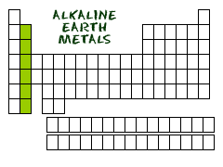
Alkaline Earth Metals
Group 2A elements
Each has 2 electrons in it’s outer shell

Slide 21
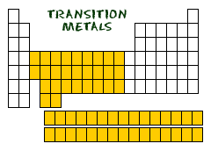
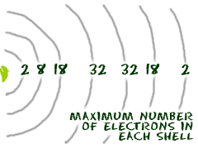
Transition elements
Able to put more than 8 electrons in their 2nd to last shell.
Up to 32 electrons
Can bond with their two outer orbitals in a variety of shapes.

Slide 22
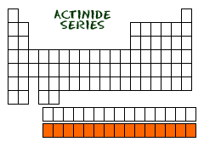
Transition metals
A type of group B element that is contained in the d-block of the periodic table and, with some exceptions.
All radioactive, some not found in nature.

Slide 23
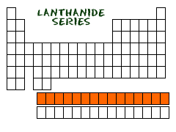
Inner Transition Metals
A type of group B element that is contained in the f-block of the periodic table and is characterized by a filled outermost s orbital, and a filled or partially filled 4f and 5f orbital.
Only found in nature.

Slide 24
Non-Metals
Elements that are generally gases or brittle dull-looking solids.
Poor conductors of heat and electricity.

Slide 25
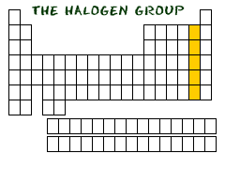
Halogens
Highly reactive group of 7A
Have 7 electrons in their outer shell
Bond very easily with things
Especially Group…

Slide 26
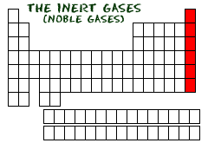
Nobel Gases (inert gases)
Unreactive group 8A.
Full outer electron shell.
8 electrons, except He (2)

Slide 27
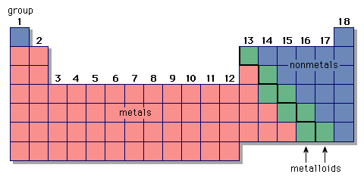
Metalloids
Elements with physical and chemical properties of both metals and nonmetals.

Slide 29
Let the Competition begin
What type of metal is Potassium?
Alkali metals
True or False. Groups are the horizontal rows going left to right.
False. Periods are.
What is the electron configuration of Sodium?
1s¹2s²2p⁶3s¹

Slide 30
How many valence electrons alkaline earth metals have?
Two
What is unique about nobel gases?
They have a full outer orbital with 8 valence electrons and are NONREACTIVE.
Give me three of the four characteristics that metals have?
Shiny and smooth when clean
Solid at room temperature
Good conductors of heat and electricity
Malleable and ductile

Slide 31
How many elements are metalloids? Name them.
8: boron, Silicon, Germanium, Arsenic, Antimony, Tellurium, Polonium, Astatine
How many groups and periods are there?
8 groups
7 periods
Fill in the blank: atoms in the same group have similar chemical properties because they have the same number of _________ _________.
Valence electrons

Slide 32
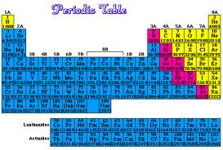
What colors correlate with metals, nonmetals, and metalloids.
Blue
Metals
Yellow
Nonmetals
Pink
metalloids

Slide 33
Group 7 is known as _________ and what about their electron configuration allows these elements to be grouped together?
Halogens. They all fill up to p6 on the periodic table.
What block is Einsteinium located in?
F block
If an elements valance electrons are in the fourth energy level, what period is it located in?
Fourth period ie [Ar] 4s²3d^{1o}4p¹

Slide 34
Give the following information for this electron configuration: [Ar] 4s²3d¹⁰4p⁶
Element name
Group number
Period number
Family name
Metal, nonmetal, or metalloid
Element name : Krypton
Group number: 8A
Period number: 4
Family name: noble gases
Metal, nonmetal, or metalloid: nonmetal

Slide 35
Final Question
Sketch the periodic table on your white board and indicate the location of:
groups
periods
metals
nonmetals
metalloids
and s-,p-,d-,f- blocks

