Slide 1
Chromosomes
and inheritance

Slide 2
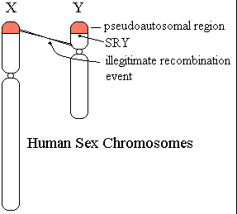
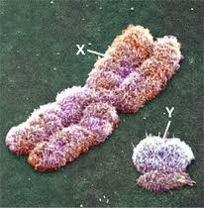
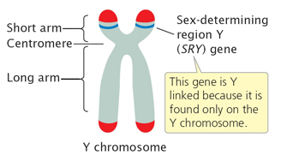
Sex Determination
1. Thomas Hunt Morgan (Early 1900s) – experimented with small fruit flies.
Each had 4 pairs of chromosomes – 3 pr. Identical and 1 pr. Different.
Discovered sex chromosomes – X and Y (X much larger than the Y)
Y chromosomes has SRY gene (sex determining region) – produces testes
(protein)

Slide 3
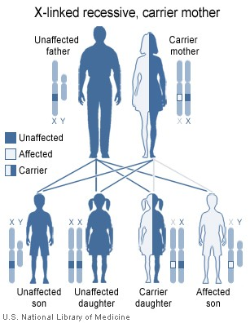
Sex Linkage (Sex linked traits)
Presence of a gene on a sex chromosome is called sex linkage.
X chromosome larger, therefore carries more genes that Y chromosome and has more sex linked traits or characteristics.
X-linked genes– genes found on X chromosome
Y-linked genes – genes found on Y chromosome
Sex linked genes and traits
Females – XX chromosomes
Males – X and Y chromosome

Slide 4
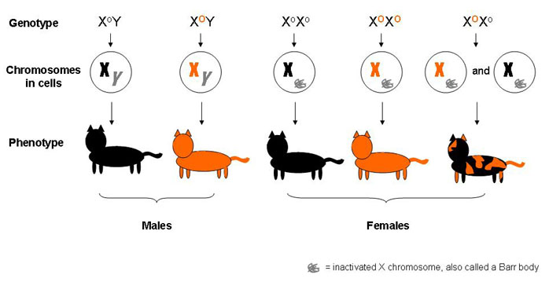
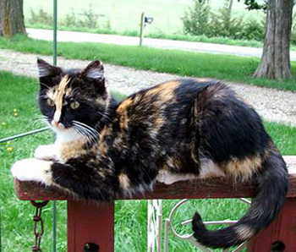
Sex Linkage cont.
In females, a dominant allele on one X chromosome will mask a recessive allele on the other X chromosome.
NOT THE SAME FOR MALES, THOUGH.
In males, no matching allele on the Y chromosome to mask or hide the allele on the X chromosome.
As a result , any allele of the X chromosome (even recessive) will produce the trait in a male who inherits it.

Slide 5
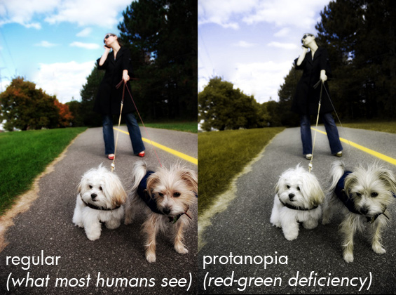
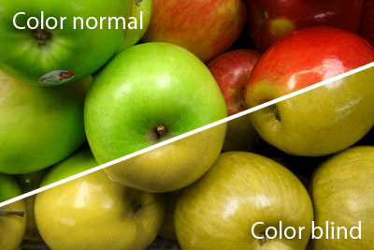
Sex Linkage cont.
Because males have only ONE X chromosome, they are more likely than females to have a sex-linked trait controlled by a recessive allele.
Example 1: Red-Green Colorblindness (controlled by recessive allele)

Slide 6
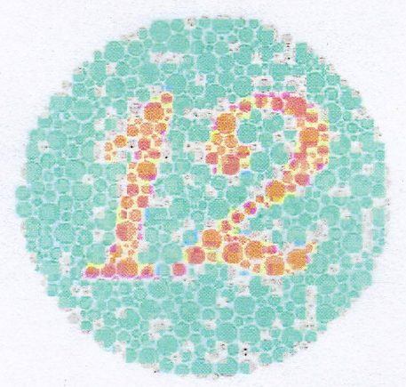
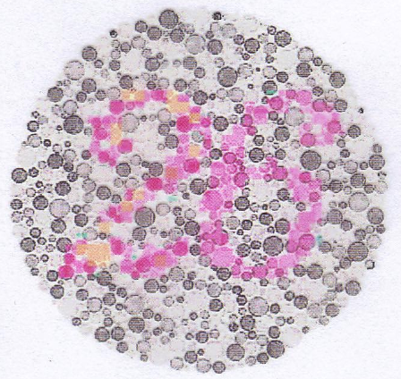
What number do you see?

Slide 7
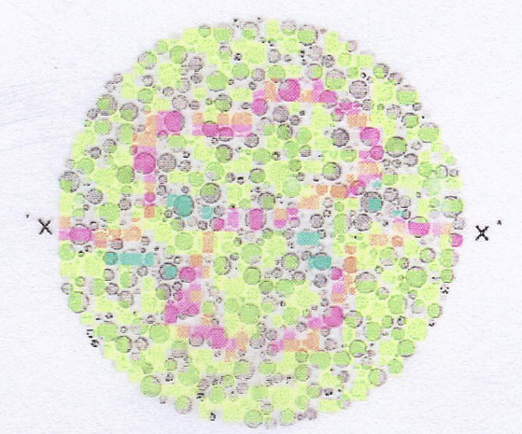
Can you trace the line from one x to the other x?

Slide 8
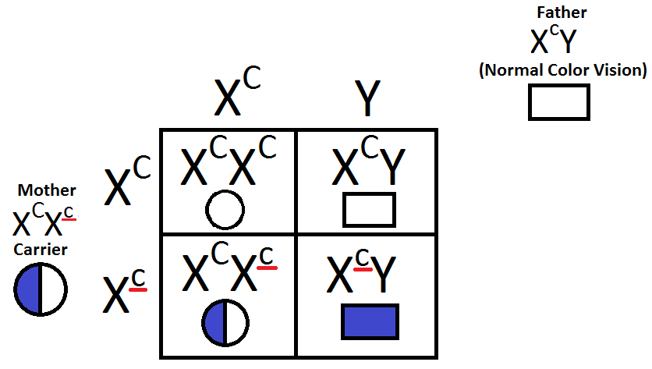
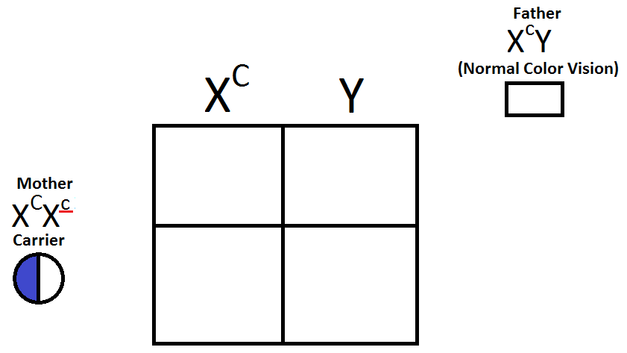
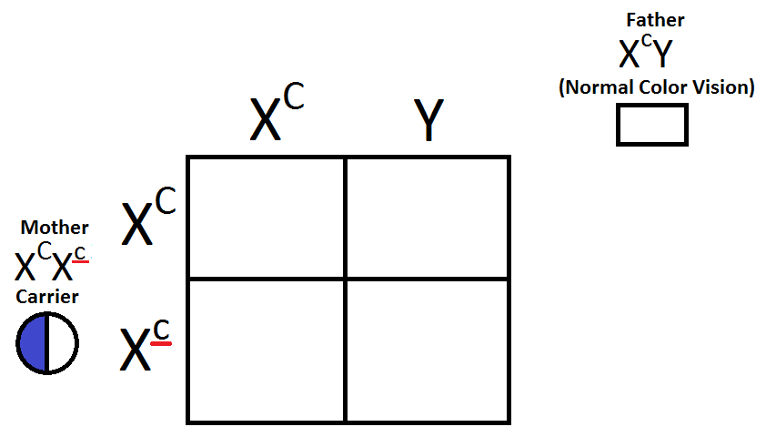
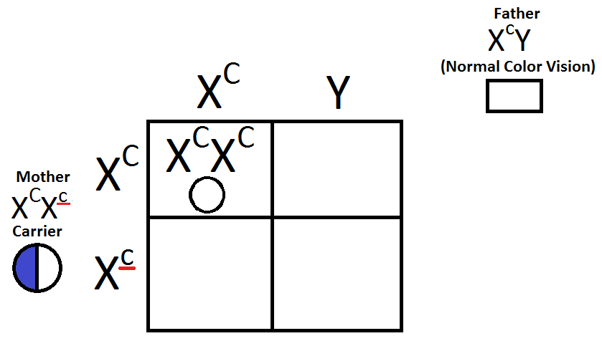
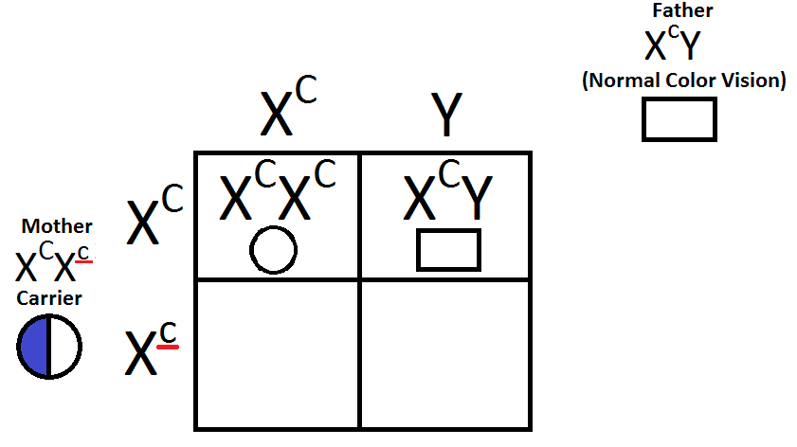
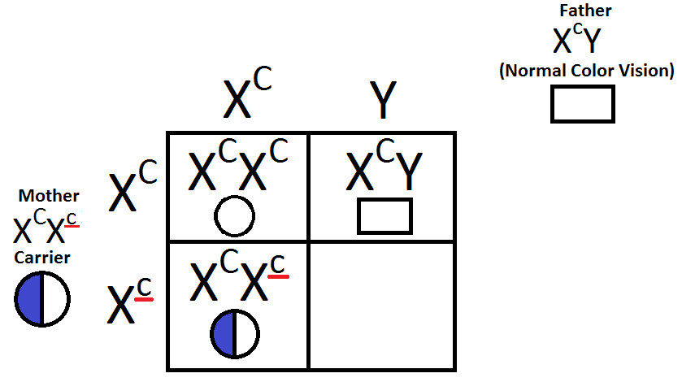
Example 1: Red-Green Colorblindness
Complete the Punnett Square to show color-blindness.
The mother is a carrier. This is a person who has ONE recessive allele for a trait and ONE dominant allele for the trait.
She does NOT have the trait, but can pass it to her offspring.

Slide 9
Color-blindness Punnett Square Questions
What is the probability that the couple above will have a colorblind child?
25%
What is the probability that the SONS will be colorblind?
50%
What is the probability that the DAUGHTERS will be colorblind?
0%

Slide 10
Color-blindness Punnett Square Questions
What is the probability that the DAUGHTERS will be carriers for colorblindness?
50%
What would have to occur for the daughters to be colorblind?
She must receive 2 recessive alleles for colorblindness (ONE from each parent).
Why is it that the sons could be more prone to colorblindness?
He must inherit (receive) only ONE recessive allele. This is due to there being no gene for color vision on the Y chromosome.

Slide 11
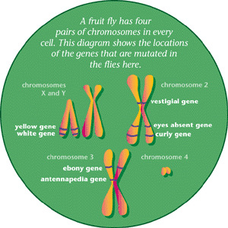
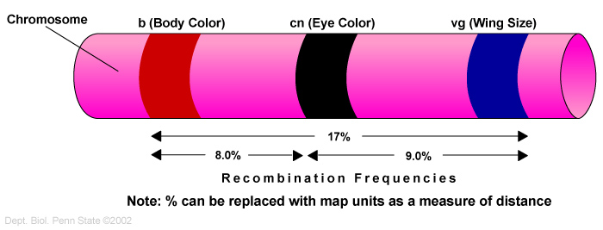
Linkage Groups
Each chromosome carries many genes.
Genes on 1 chromosome form a linkage group.
2 or more genes found on the same chromosome are linked and tend to be inherited together.

Slide 12
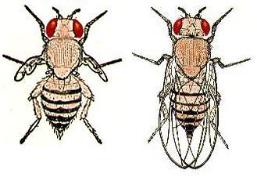
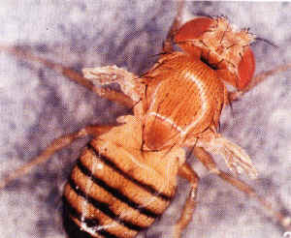
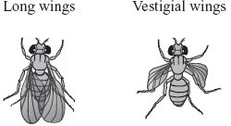
Linkage Groups Example
Fruit fly body color and wing length (Morgan experimented again)
Gray body (G) was dominant to black body (g)
Long wings (L) were dominant to short wings (l)
GGLL x ggll = GgLl (100% gray with long wings)
GgLl x GgLl = 3 gray long wings and 1 black short wing
Because on same chromosome, results were similar

Slide 13
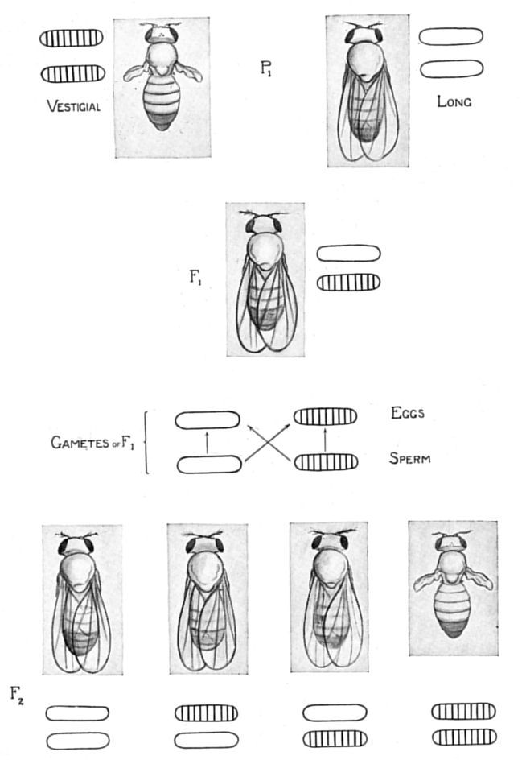
Linkage Groups Cont.
4. Crossing over only changes locations of genes among chromosomes.
IT DOES NOT create or delete genes.

Slide 14
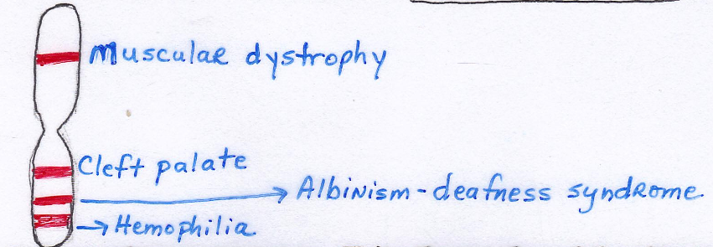
Chromosome Mapping
Definition: a diagram showing order of genes on a chromosome.
The more distance between 2 genes on a chromosome, the more likely a cross-over will occur (new combos of traits)

Slide 15
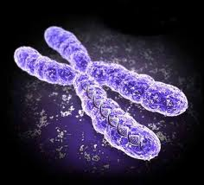
Fill in the disorders located with the Human X chromosome
Look at the large chromosome map. Write the number of the chromosome associated with each disorder. (Look at map from earlier)

Slide 16
Disorders Human X chromosome
Lou Gehrig’s Disease 21
Hemophilia “X”
Cystic Fibrosis 7
Alzheimer’s Disease 14
Breast Cancer 17
Colon Cancer 2
Sickle cell anemia 11
Melanoma 9
What connection is there between Chromosome #2 and Chromosome #5?
Increase risk of colon cancer

Slide 17
Mutations
Definition: Change in DNA/ genetic code
Can involve an entire chromosome or a single DNA nucleotide and may take place in any cell
Germ Cell Mutations – occur in gametes (won’t affect the organism but may be passed to offspring)

Slide 18
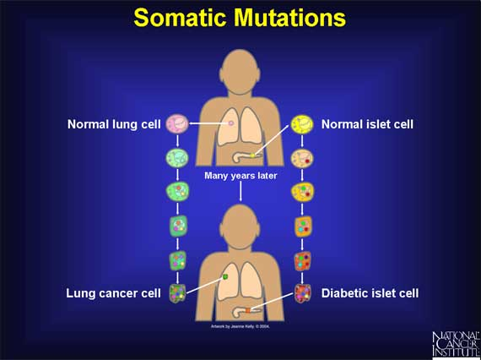
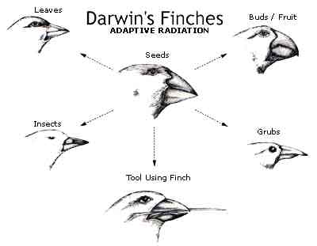
Mutations cont.
4. Somatic Mutations (not inherited) – occur in body cells and can affect organisms
Ex. Skin cancer and Leukemia
Lethal Mutations – causes death (usually before birth)
Some mutations beneficial to organism’s survival
Ex. Variations of species (DARWIN)

Slide 19
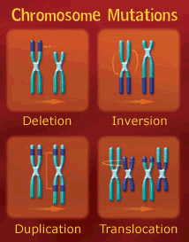
Chromosome Mutations
Involve changes in the structure of a chromosome or the loss or gain of a chromosome

Slide 20
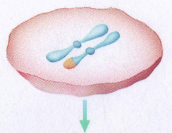
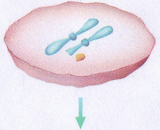
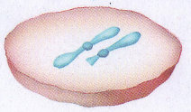
Deletion
Deletion – loss of a piece of chromosome due to breakage

Slide 21
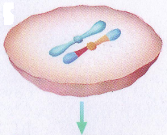
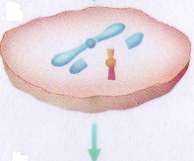
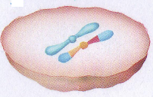
Inversion
Inversion – A chromosomal segment breaks off, flips around backwards, and reattaches.

Slide 22
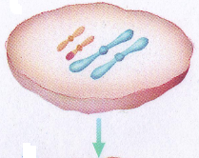
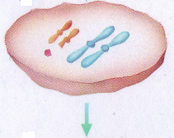
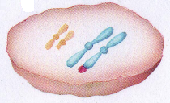
Translocation
Translocation – a piece of one chromosome breaks off and reattaches to a nonhomologous chromosome

Slide 23
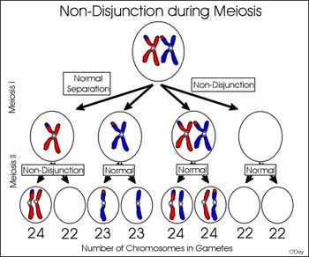
Nondisjunction
Nondisjunction – a chromosome fails to separate from its homologue during meiosis
Ex. 1 gamete receives an extra copy of a chromosome; a gamete receives no copy of a chromosome.
Down’s Syndrome #21

Slide 24
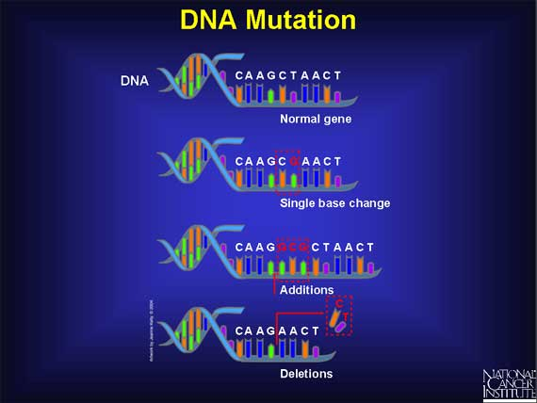
Gene Mutations
Involve large segments of genes or a single nucleotide. (DNA)
A single nucleotide is substituted, added, or removed. More about this as it relates to DNA with our DNA unit.

Slide 25
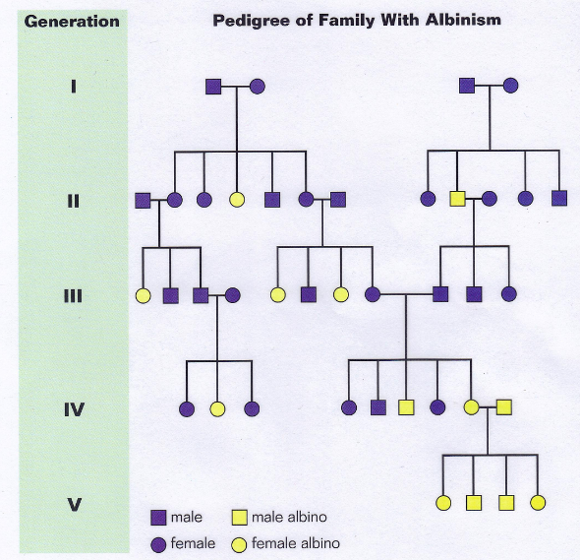
Pedigrees
Definition: diagram that shows how a trait is inherited over generations.
Squares = males Circles = females

Slide 26
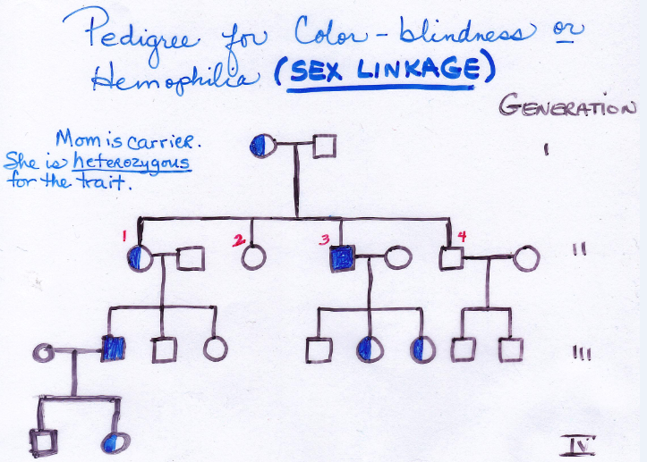
Pedigree cont.
Sketch the pedigree and be able to understand the meaning of the shading of the symbol.
Pedigree for Hemophilia
(Blood-
clotting
disorder)

Slide 27
Pedigree for Hemophilia
Why do male offspring inherit the disease more readily than females?
Recessive x-linked allele
X-linked dominant alleles affect both males and females, although males may be more severely affected since they inherit only a single X chromosome and thus lack a compensating normal allele.
Males inherit the allele from their mother and develop the disease.
Since (until recently) the prognosis for survival was poor and hemophiliac males did not survive to pass on the allele to their daughters (its on the X-chromosome). Therefore female hemophiliacs where rare.

